Slide 1
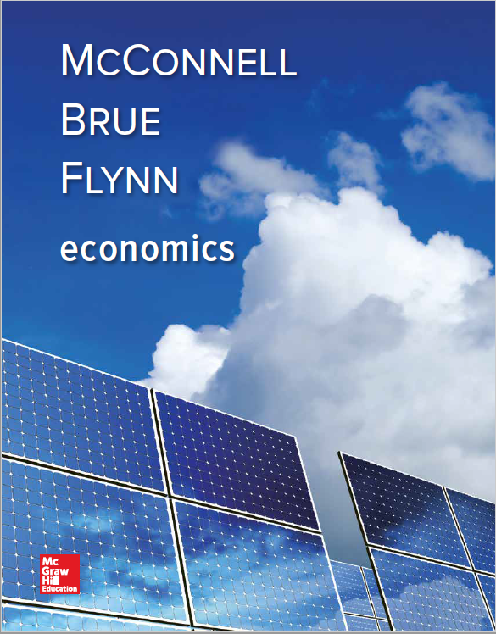
Chapter 34
Money, Banking, and Financial Institutions
Notes:
1
In this chapter, we start by looking at the functions of money and the definitions of the money supply. Then there is a discussion of the factors that back the money supply. In this chapter, you will be introduced to the U.S. banking system, in particular, the Federal Reserve. You will learn about the organization and function of the Fed. Then we will talk about the financial crisis of 2007–08 and how the financial system has changed as a result. In the Last Word, electronic banking is addressed.

Slide 2
Functions of Money
Medium of exchange
Used to buy and sell goods
Unit of account
Goods valued in dollars
Store of value
Hold some wealth in money form
Money is liquid
LO1
Notes:
Which function of money is considered the most important depends upon circumstances. In economics, we typically focus on money as a medium of exchange and a store of value. We use money as a unit of account in measuring GDP and other economic measures. As a medium of exchange, money allows an economy to function efficiently. Without it, trade would be difficult as each party would have to seek out someone else who has the desired product or service and then trade. If the party with the desired product does not want the good, there might have to multiple exchanges in order to get the desired product. As a unit of account, money provides a consistent way to value business activity so comparisons can be made. As a store of value money allows for a person to amass wealth without having to keep actual products which might not be possible to keep long-term.

Slide 3
Money Definition M1
M1
Currency
Checkable deposits
Institutions offering checkable deposits
Commercial banks
Savings and loan associations
Mutual savings banks
Credit unions
LO2
Notes:
Note that checkable deposits include smaller components such as traveler’s checks. Currency includes coins and paper money. Currency is referred to as token money, which means the face-value of the currency is unrelated to its intrinsic value. This means the face-value of the currency exceeds the actual value of the piece of paper it is printed on or the value of the metal in the coin. At one time, coins were actually made of valuable metals such as gold or silver. Today, those coins’ actual values are worth more than the face-value of the metal in the coin.
Collectively, S & Ls, mutual savings banks, and credit unions are known as “thrifts.”
Currency held by the Fed, commercial banks, and thrift institutions are also excluded from M1.

Slide 4
Money Definition M2
M2
M1 plus near-monies
Savings deposits including money market deposit accounts (MMDA)
Small-denominated time deposits
Money market mutual funds (MMMF)
LO2
Notes:
Small-denominated time deposits are less than $100,000.
M2 money supply is about 5 times larger than M1.
These types of accounts are readily available for withdrawal from the institution holding the deposit.

Slide 5
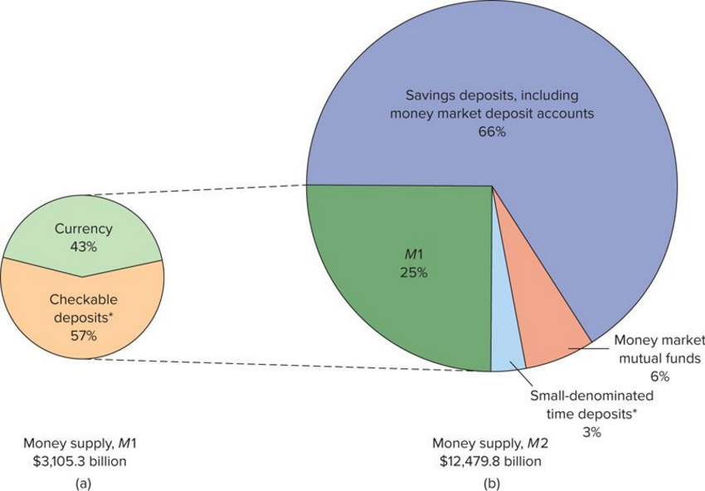
Money Definitions
LO2
Notes:
This chart shows the distribution of M1 and M2 and helps to illustrate the fact that M1 is a small fraction of the total money supply. Most of the supply is tied up in some type of time deposit, which means the money may not be available when needed.

Slide 6
What “Backs” the Money Supply?
Guaranteed by government’s ability to keep value stable
Money as debt
Why is money valuable?
Acceptability
Legal tender
Relative scarcity
LO3
Notes:
Credit cards are not considered money; however, they allow businesses and individuals to “economize” the use of money. Debit cards come from checking accounts and are considered money. At one time, the money supply of a nation was linked to the nation’s gold supply, on what was called the gold standard. Most nations moved away from the gold standard because managing the supply of money is more sensible than linking it to gold or some other commodity whose supply might change arbitrarily. In modern society people are willing to accept money in exchange for goods or services because they know they will be able to exchange the money for other goods or services. Our currency is designated as legal tender by the United States government, which means it is deemed a valid and legal means of paying any debt that was contracted in dollars. Money derives part of its value from its scarcity. The supply of money is controlled by monetary authorities to ensure it retains its value or “purchasing power.”

Slide 7
What “Backs” the Money Supply? Continued
Prices affect purchasing power of money
Hyperinflation renders money unacceptable
Stabilizing money’s purchasing power
Intelligent management of the money supply — monetary policy
Appropriate fiscal policy
LO3
Notes:
The purchasing power of money is the amount of goods and services a unit of money will buy. If the price level of goods goes up, the value of a dollar goes down in a reciprocal relationship. Periods of hyperinflation happen when governments issues so many pieces of paper currency that the purchasing power of each is totally undermined. Post-World-War I Germany experienced hyperinflation that many historians believe contributed to the Second World War. Governments have a vested interest in ensuring a stable money supply to keep the economy on a steady pace.

Slide 8
Federal Reserve — Banking System
Historical background
Board of Governors
12 Federal Reserve Banks
Serve as the central bank
Quasi-public banks
Banker’s bank
LO4
Notes:
The Federal Reserve System serves as the monetary authority that controls the money supply for our country. Congress passed the Federal Reserve Act of 1913 to try to prevent the acute problems in the banking system that had plagued the country early in the twentieth century. The Board of Governors is the central authority. The seven Board members are appointed by the U.S. president for 14-year terms that are staggered so that one member is replaced every two years. The long term provides the Board with continuity, experienced membership, and independence from political pressures.
The 12 Federal Reserve Banks implement the decisions of the Board of Governors and are aided by the Federal Open Market Committee. The Banks are quasi-public banks meaning they blend private ownership and public control. Each Bank is privately owned by the private commercial banks in its district. Unlike private institutions, however, they are not motivated by profit but rather seek to promote the well-being of the economy as a whole. They perform essentially the same services for commercial banks as those institutions perform for the public. In emergency circumstances, the Banks become the “lender of last resort” to the banking system. After 9/11, the Fed lent $45 billion to U.S. banks and thrifts to ensure the stability of the banking system. Under normal circumstances the Fed lends around $150 million per day.

Slide 9
Federal Reserve — Banking System Continued
Board of Governors
Federal Open Market Committee
12 Federal Reserve Banks
Commercial Banks
Thrift Institutions
(Savings and Loan Associations,
Mutual Savings Banks,
Credit Unions)
The Public
(Households and
Businesses)
LO4
Notes:
The Federal Open Market Committee is a group of 12 individuals, including the seven members of the Board of Governors, the president of the New York Federal Reserve Bank, and four of the remaining presidents of Federal Reserve Banks on 1-year rotating terms. They meet regularly to direct the purchase and sale of government securities. The purpose of these activities is to control the nation’s money supply and influence interest rates.

Slide 10
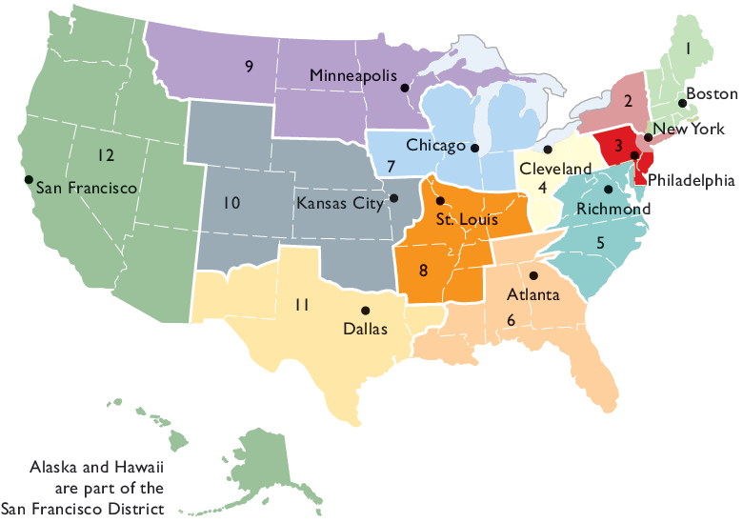
Federal Reserve Banks
The 12 Federal Reserve Banks
LO4
Notes:
Note the concentration of banks in the northeast. This reflects population densities at the time that the Federal Reserve System was set up. At that time, the west was largely unsettled and still wilderness so there was not a great demand for banks.

Slide 11
Federal Reserve — Banking System Concluded
Federal Open Market Committee
Aids Board of Governors in setting monetary policy
Conducts open market operations
Commercial banks and thrifts
6,000 commercial banks
8,500 thrifts
LO4
Notes:
The most common thrift institutions are credit unions. In addition to being subject to the monetary control of the Fed, banks and thrifts are subject to regulation by various agencies such as the Federal Deposit Insurance Corporation and the National Credit Union Association. Both banks and thrifts are required to keep a certain percentage of their checkable deposits as reserves.

Slide 12
Financial Institutions
LO4
Notes:
This bar chart represents the 12 largest financial institutions in the world as of 2015. Their assets have all been translated into U.S. dollars for comparison purposes.

Slide 13
Federal Reserve Functions
Issue currency
Set reserve requirements
Lend money to banks
Collect checks
Act as a fiscal agent for U.S. government
Supervise banks
Control the money supply
LO5
Notes:
Note that contrary to public opinion, the Fed does not “set” the interest rate that most people pay. It sets a discount rate that it charges to banks for short-term loans, which then contributes to the rate that the banks charge customers on their loans. While the Fed has the ability to issue Federal Reserve Notes, the paper currency used in the U.S. monetary system, they do not print the money. That task is still performed by the U.S. Mint. The Fed also facilitates the movement of money by providing the banking system with a means of collecting on checks. It also acts as the fiscal agent for the federal government by collecting money owed to the government from taxes and assisting with the government spending of equally large amounts. The Fed makes periodic examinations to asses bank profitability, to ascertain that banks perform in accordance with the many regulations to which they are subject, and to uncover questionable practices or fraud. After the financial crisis of 2007-2008, Congress increased the Fed’s supervisory powers.

Slide 14
Federal Reserve Independence
Established by Congress as an independent agency
Protects the Fed from political pressures
Enables the Fed to take actions to increase interest rates in order to stem inflation as needed
LO5
Notes:
There are two types of federal agencies: independent agencies and executive agencies. Executive agencies fall directly under the control of the President and, therefore, may be prone to political pressures. Independent agencies do not report directly to the executive branch of government. As an independent agency, the Fed tends to avoid the political pressures that Congress and the executive branch face that sometimes result in inflationary fiscal policies.

Slide 15
The Financial Crisis of 2007 and 2008
Mortgage Default Crisis
Many causes
Government programs that encouraged home ownership
Declining real estate values
Bad incentives provided by mortgage-backed bonds
LO6
Notes:
The causes of the financial crisis of 2007-2008 are still being debated, but most authorities feel that the mortgage default crisis was a key component. Most banks and regulators had mistakenly believed that the innovation known as “mortgage-backed securities” had eliminated most of the bank’s exposure to mortgage defaults. Mortgage-backed securities are bonds backed by mortgage payments. It was thought that this was a smart business decision as these mortgage-backed securities transferred any future default risk on those mortgages to the buyer of the bond, instead of the bank. Unfortunately, the banks took the money that they received for the bonds and loaned it to other investors, and once the defaults started, it was like a house of cards. Once one card was removed, the whole house collapsed.
Visit http://crisisofcredit.com/ for a great video explanation.

Slide 16
The Financial Crisis of 2007 and 2008 Continued
Securitization — the process of slicing up and bundling groups of loans into new securities
As loans defaulted, the system collapsed
“Underwater” homeowners abandoned homes and mortgages
LO6
Notes:
The system probably could have survived the failure of one component in the system but unfortunately all three elements collapsed at once. Interest rates increased on adjustable mortgages at the same time that house prices fell. Borrowers began to fall behind on their mortgages as the economy slowed and their payments increased. Many just literally walked away from their houses and their mortgages, leaving the mortgage holder with a property that was worth significantly less than the value of the loan.

Slide 17
The Financial Crisis of 2007 and 2008 — Failures
Failures and near-failures of financial firms
Countrywide: second largest lender
Washington Mutual: largest lender
Wachovia
Other firms came close
LO6
Notes:
The big mortgage holders ran into trouble because they held large amounts of the bad debt because of the failure of the mortgage-based securitization system. Countrywide and Washington Mutual were both saved from bankruptcy by other banks who bought them out. As the direct mortgage lenders struggled, the troubles grew to include other financial institutions, many of whom had to take advantage of massive emergency loans made available by the Federal Reserve.

Slide 18
The Financial Crisis of 2007 and 2008 — Fiscal Response
Troubled Asset Relief Program (TARP)
Allocated $700 billion to make emergency loans
Saved several institutions from failure
LO7
Notes:
Congress passed TARP in 2008 to try to save the financial institutions that were adversely affected by the crisis. However, the process of the government “bailing out” a business is subject to much debate. Is the moral hazard that was created when the federal government bailed out those firms that made bad investment decisions benefiting those firms and, in effect, penalizing firms who played by the rules? Do some firms make risky investments knowing that they are “too big to fail” and that, therefore, government will step in and save them?

Slide 19
Post-Crisis U.S. Financial Services
Major categories of financial institutions
Commercial banks
Thrifts
Insurance companies
Mutual fund companies
Pension funds
Securities firms
Investment banks
LO8
Notes:
During the financial crisis of 2007-2008, there was tremendous consolidation in the industry, and this blurred the lines between segments. More than 200 banks were shut down by the FDIC, and their assets were transferred to other banks. Major investment banks opted to become commercial banks to gain access to emergency Federal Reserve loans.

Slide 20
Major Categories of Financial Institutions
Institution | Description | Examples
Commercial Banks | State and national banks that provide checking and savings accounts and make loans | JP Morgan Chase, Bank of America, Citibank, Wells Fargo
Thrifts | Savings and loan associations, mutual savings banks, credit unions that offer checking and savings accounts and make loans | Charter One, New York Community Bank
Insurance Companies | Firms that offer policies through which individuals pay premiums to insure against lose | Prudential, New York Life, Northwestern Mutual, Hartford
Mutual Fund Companies | Firms that pool customer deposits to purchase stocks or bonds | Fidelity, Vanguard, Putnam, Janus, T Rowe Price
Pension Funds | Institutions that collect savings from workers throughout their working years and then invest the funds to pay retirement benefits | TIAA-CREF, Teamsters’ Union, CalPERs
Securities Firms | Firms that offer security advice and buy and sell stocks and bonds for clients | Merrill Lynch, TD Ameritrade, Charles Schwab
Investment Banks | Firms that help corporations and governments raise money by selling stocks and bonds | Goldman Sachs, Morgan Stanley, Deutsche Bank, Credit Suisse
LO8
Notes:
These are examples of some of the largest financial institutions in each category.

Slide 21
Post-Crisis U.S. Financial Services Continued
Wall Street Reform and Consumer Protection Act
Passed to help prevent many of the practices that led to the crisis
Critics say it adds heavy regulatory costs
LO8
Notes:
Many critics say this regulation was unnecessary as regulators already had the tools that they needed, they just weren’t using them. It is too soon to evaluate whether this law will help to prevent another financial crisis.

Slide 22
Extend and Pretend
Fed had to act as lender of last resort for both solvent and insolvent firms
Increased moral hazard
Notes:
During the financial crisis, the Fed made the decision to makes loans not only to firms that were solvent but illiquid, but also to firms that were insolvent and illiquid. The thought was if the insolvent firms went under, they would take the solvent firms with them. By doing so, the question is did the Fed increase the moral hazard going forward in that firms will be more willing to engage in risky behavior because they will expect the Fed to bail them out.

