Slide 1
Chapter 29
Business Cycles, Unemployment, and Inflation
Notes:
This chapter previews the business cycle, unemployment, and inflation. It is an important chapter as it sets the stage for the analytical presentation in later chapters.

Slide 2
The Business Cycle
Alternating increases and decreases in economic activity over time
Phases of the business cycle
Peak
Recession
Trough
Expansion
LO1
Notes:
Business cycles are alternating increases and decreases in economic activity over time. Each business cycle consists of four phases. A peak is when business activity reaches a temporary maximum with full employment and near-capacity output. A recession is a decline in total output, income, employment, and trade lasting six months or more; this is sometimes referred to as an economic contraction. The trough is the bottom of the recession period and the expansion is when output and employment are recovering and expanding toward the full employment level.

Slide 3
The Business Cycle Continued
Peak
Peak
Trend
Peak
Level of real output
Growth
Expansion
Recession
Expansion
Trough
Recession
Trough
Time
LO1
Notes:
This figure shows the business cycle. Economists distinguish four phases of the business cycle; the duration and strength of each phase may vary. Additionally, individual cycles vary in duration and intensity. You can see that the long run trend is economic growth.

Slide 4
The Business Cycle: Recessions
U.S. Recessions since 1950
Period | Duration, Months | Depth (Decline in Real Output)
1953-54 | 10 | -2.6%
1957-58 | 8 | -3.7
1960-61 | 10 | -1.1
1969-70 | 11 | -0.2
1973-75 | 16 | -3.2
1980 | 6 | -2.2
1981-82 | 16 | -2.9
1990-91 | 8 | -1.4
2001 | 8 | -0.4
2007-09 | 18 | -4.3
Source: National Bureau of Economic Research, www.nber.org, and Minneapolis Federal Reserve Bank, www.minneapolisfed.gov. Output data are in 2000 dollars
LO1
Notes:
The NBER is a nonprofit economic research organization. Within the NBER is the Business Cycle Dating Committee whose job it is to declare the start and the end of recessions in the U.S. They declared that the 2007 recession began in December 2007 and ended in June 2009.

Slide 5
The Business Cycle Concluded
Business cycle fluctuations
Economic shocks
Prices are “sticky” downwards
Economic response entails decreases in output and employment
LO1
Notes:
The United States’ long run economic growth has been interrupted by periods of instability. Uneven growth has been the pattern, with inflation often accompanying rapid growth, and declines in employment and output during periods of recession and depression. Economic shocks are unexpected events that individuals and firms may have trouble adjusting to. Prices can be inflexible downwards which means that if total spending unexpectedly decreases and firms cannot lower prices, the firms will end up selling fewer units of output. The “sticky” prices result in slower sales which will cause firms to cut back on production; this causes GDP to fall. Then employment will fall because of the reduced demand for output and an economic contraction will occur. Inflexible prices are thought to be a major factor in preventing the economy from quickly adjusting to economic shocks. These shocks are outlined on the next slide.

Slide 6
Causation: A First Glance
Causes of shocks
Irregular innovation
Productivity changes
Monetary factors
Political events
Financial instability
Recession of 2007
LO1
Notes:
The following are economic shocks that can cause business cycles. Major innovations may trigger new investment and/or consumption spending. But these occur irregularly and unexpectedly and may contribute to the variability of economic activity. Examples include the computer and the internet. Changes in productivity may be a related cause. Unexpected changes in resource availability or unexpected changes in the rate of technological advances can affect productivity.
As the monetary authorities print more money, an inflationary boom can occur. Printing less money than what people were expecting can trigger an output decline.
As the economy adjusts to political events like peace treaties or war, economic strains can occur. Rapid asset price increases or decreases can spill over to the general economy and cause booms and busts. The recession of 2007 was led by excessive money, overvalued real estate, and unsustainable mortgage debt.

Slide 7
Cyclical Impact
Durable goods affected most
Capital goods
Consumer durables
Nondurable consumer goods affected less
Services
Food and clothing
LO1
Notes:
Most agree that the level of aggregate spending is important, especially the changes in spending on capital goods and consumer durables. Recall that the definition of durable goods is a good with an expected life of 3 or more years. Spending on durable goods output is more volatile than nondurables and services because spending on nondurables or services often cannot be postponed. Also, durable goods items such as a new automobile or a new washer and dryer are generally more expensive for households to purchase, making durable goods more vulnerable in times of declining income and uncertainty for households.

Slide 8
Unemployment
Under 16
and/or Institutionalized (69.5 million)
Unemployment rate =
# of unemployed
labor force
× 100
Not in
labor
force
(94.1 million)
Total population (321.4 million)
Unemployment rate =
7,900,000
157,800,000
× 100 = 5.0%
Employed
(149.9 million)
Labor force (157.8 million)
Unemployed
(7.9 million)
LO2
Notes:
The BLS is the Bureau of Labor Statistics, an agency within the Department of Labor. The unemployment rate is calculated by taking a random survey of 60,000 households nationwide. (Note: Households are in the survey for four months, out for eight, back in for four, and then out for good. Interviewers use the phone or home visits using laptops.)
The population is divided into three groups:
Group 1 consists of those under age 16 or institutionalized. In this country, if you are under 16 you are expected to be in school. If you are in an institution such as a nursing home or prison you obviously cannot present yourself to the labor market.
Group 2 consists of those “not in labor force”. Examples of individuals who are not in the labor force are full-time college students who are not working, stay at home parents, and retirees.
Group 3 consists of those age 16 and over who are willing and able to work, and actively seeking work (individuals who have demonstrated job search activity within the last four weeks).
So, Group 3 is the labor force. The labor force is simply described as those who are either employed or unemployed. To be counted as unemployed you must be a part of the labor force.
Figure 29.2 shows the labor force, employment, and unemployment in 2015. The labor force consists of persons 16 years of age or older who are not in institutions and who are employed, or unemployed but seeking employment. The unemployment rate is defined as the percentage of the labor force that is not employed and is found by taking the number of those unemployed and dividing that number by the labor force. Remember to multiply the result by 100 so you can express this as a percentage. The BLS rounds the number to one decimal point.

Slide 9
Unemployment Continued
Criticisms of unemployment
Involuntary part-time workers counted as full-time
Discouraged workers are not counted as unemployed
LO2
Notes:
Two factors cause the official unemployment rate to understate actual unemployment. Part-time workers are counted as “employed” even if they really want full-time work. “Discouraged workers” who want a job, but are not actively seeking one, are not counted as being in the labor force, so they are not part of the unemployment statistic. If they are not seeking work, they are officially in group 2 as described on the preceding slide. In 2015, 664,000 people fell into this category, compared to 396,000 in 2007.

Slide 10
Unemployment Concluded
Frictional unemployment
Individuals searching for jobs or waiting to take jobs soon
Structural unemployment
Occurs due to changes in the structure of the demand for labor
Cyclical unemployment
Caused by the recession phase of the business cycle
LO2
Notes:
Frictional unemployment is regarded as somewhat desirable, because it indicates that there is mobility as people change or seek jobs. Frictional unemployment is usually a short term type of unemployment. Structural unemployment occurs when certain skills become obsolete or geographic distribution of jobs changes. This can be a long-term type of unemployment. Cyclical unemployment is caused by the recession phase of the business cycle. As firms respond to insufficient demand for their goods and services, output and employment are reduced.
Extreme unemployment during the Great Depression (25 percent in 1933) is an example of cyclical unemployment.
It is sometimes not clear which type describes a person’s unemployment circumstances.

Slide 11
Definition of Full Employment
Natural Rate of Unemployment (NRU)
Full employment level of unemployment
Can vary over time
Demographic changes
Changing job search methods
Public policy changes
Actual unemployment can be above or fall below the NRU
LO2
Notes:
Full employment does not mean zero unemployment, but it does mean that cyclical unemployment is zero. The full employment-unemployment rate is equal to the total frictional and structural unemployment because these types of unemployment are always occurring and are a natural part of our economy. The full employment rate of unemployment is also referred to as the natural rate of unemployment.
The natural rate is achieved when labor markets are in-balance; the number of job seekers equals the number of job vacancies. The natural rate of unemployment is not fixed but depends on the demographic makeup of the labor force and the laws and customs of the nation.

Slide 12
Economic Cost of Unemployment
GDP Gap
GDP gap = actual GDP - potential GDP
Can be negative or positive
Okun’s Law
Every 1% of cyclical unemployment creates a 2% GDP gap
LO2
Notes:
The GDP gap is the difference between potential and actual GDP where potential GDP reflects the level of GDP associated with the natural rate of unemployment. Economist Arthur Okun quantified the relationship between unemployment and GDP as follows: For every 1 percent of unemployment above the natural rate, a negative GDP gap of about 2 percent occurs. This is known as “Okun’s law.” This means that the country is producing below what could potentially be produced, given our resources and level of technology. You might liken this to operating inside of the PPC if you covered the Production Possibilities Model.

Slide 13
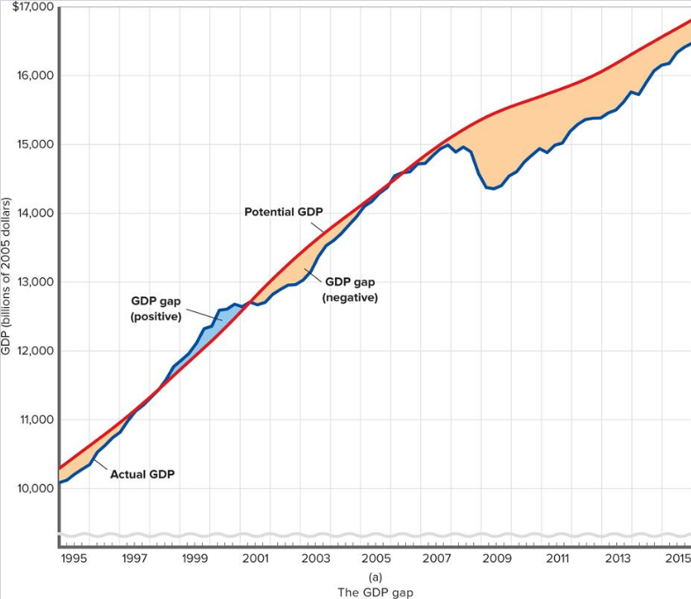
Actual and Potential Real GDP & the Unemployment Rate
LO2
Notes:
This figure shows the actual and potential real GDP and the unemployment rate from 1995-2015. (a) The difference between actual and potential GDP is the GDP gap. A negative GDP gap measures the output the economy sacrifices when actual GDP falls short of potential GDP. A positive GDP gap indicates that actual GDP is above potential GDP. (b) A high unemployment rate means a large GDP gap (negative), and a low unemployment rate means a small or even positive GDP gap.

Slide 14
Unemployment Rate
LO2
Notes:
A high unemployment rate means a large GDP gap, and a low unemployment rate means a small or even positive GDP gap.

Slide 15
Unequal Burdens
Occupation
Age
Race and ethnicity
Gender
Education
Duration
LO2
Notes:
Unequal burdens of unemployment exist, see the next slide for the table of data. Rates are lower for white collar workers. Teenagers have the highest unemployment rates. African-Americans have higher unemployment rates than whites. Rates for males and females are comparable, though females currently have a lower unemployment rate. Less educated workers, on average, have higher unemployment rates than workers with more education. The “long term” (15 weeks or more) unemployment rate is much lower than the overall rate, although it increased from 1.5% in 2007 to 4.7% in 2009.

Slide 16
Unequal Burdens Continued
Unemployment Rates by Demographic Group: Full Employment Year (2007) and Recession Year (2009)*
Demographic Group | Unemployment Rate
 | 2007 | 2009
Overall | 4.6% | 9.3%
Occupation: Managerial and professional Construction and extraction
 | 2.1 | 4.6
 | 7.6 | 19.7
Age: 16-19 African American, 16-19 White, 16-19 Male, 20+ Female, 20+
 | 15.7 | 24.3
 | 29.4 | 39.5
 | 13.9 | 21.8
 | 4.1 | 9.6
 | 4.0 | 7.5
Race and ethnicity: African American Hispanic White
 | 8.3 | 14.8
 | 5.6 | 12.1
 | 4.1 | 8.5
Gender: Women Men
 | 4.5 | 8.1
 | 4.7 | 10.3
Education:** Less than high school diploma High school diploma only College degree or more
 | 7.1 | 14.6
 | 4.4 | 9.7
 | 2.0 | 4.6
Duration: 15 or more weeks | 1.5 | 4.7
LO2
Notes:
This table illustrates civilian labor force data for people age 25 or over. As you can see, the overall unemployment rate was 4.6 percent in 2007, and 9.3 percent in 2009.

Slide 17
Noneconomic Costs
Loss of skills and loss of self-respect
Plummeting morale
Family disintegration
Poverty and reduced hope
Heightened racial and ethnic tensions
Suicide, homicide, fatal heart attacks, mental illness
Can lead to violent social and political change
LO2
Notes:
Severe unemployment is socially catastrophic as it occurs at the individual level and spreads throughout society.

Slide 18
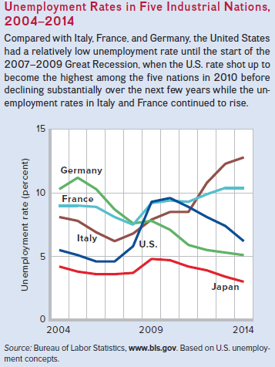
Global Perspective
LO2
Notes:
This Global Perspective shows the unemployment rates in five industrialized nations, 2004-2014. Compared with Italy, France, and Germany, the United States has had a relatively low unemployment rate in recent years.

Slide 19
Inflation
General rise in the price level
Inflation reduces the “purchasing power” of money
Consumer Price Index (CPI)
Price of the Most Recent Market
Basket in the Particular Year
CPI
=
×
100
Price estimate of the Market
Basket in 1982-1984
236.7 - 233.0
CPI
=
×
100 = 1.6%
233.0
LO3
Notes:
Not all prices rise at the same rate, and some prices may stay constant while other prices fall. Reduced purchasing power means that each dollar of income will buy fewer items than before. The CPI-U is the most commonly reported measure of inflation. The main index used to measure inflation is the Consumer Price Index (CPI). The CPI-U is the measure the media reports. This is the CPI for all urban consumers and thought to cover 87% of our population’s purchasing experiences. There are other price indexes reported by the BLS and each is important to different groups. For example, there is the CPI-W, the CPI-C, the PPI etc. To measure inflation, subtract last year’s price index from this year’s price index and divide by last year’s index. Finally, multiply by 100 to express as a percentage.
In this numerical example, using CPI data for 2014, there is a price index of 236.7 and 2013 has a price index of 233.0. You can calculate the inflation rate and find it is 1.6%. The BLS rounds to the tenths decimal place. “Rule of 70” permits quick calculation of the time it takes the price level to double: Divide 70 by the percentage rate of inflation and the result is the approximate number of years for the price level to double. Here the inflation rate is 1.6% so divide 70 by 1.6 and you get the number 43.75. Therefore, it would take about 44 years for prices to double at that rate of inflation. If the inflation rate is 7 percent, then it will take about ten years for prices to double.

Slide 20
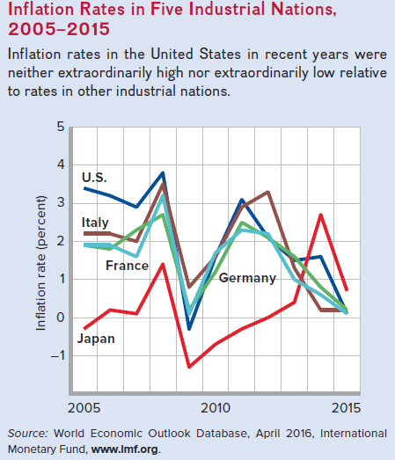
Inflation Continued
LO3
Notes:
This global perspective shows the inflation rates of five different countries. You can see that for the United States the inflation rate has been generally slightly higher than the other countries.

Slide 21
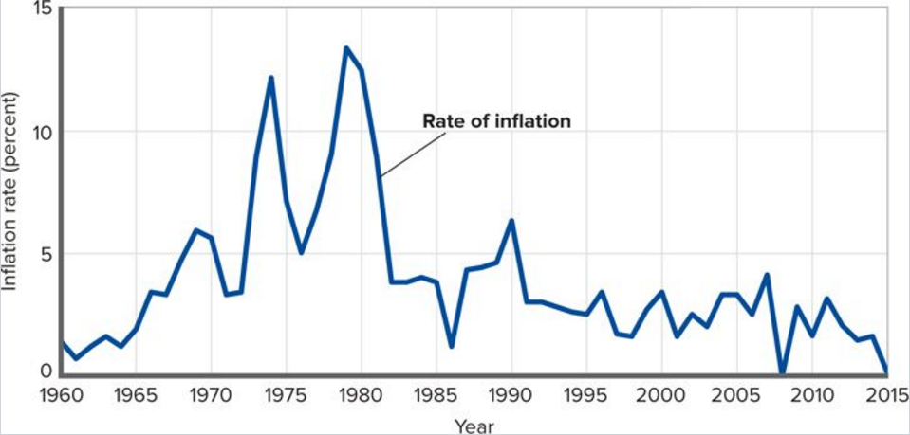
Inflation Concluded
LO3
Notes:
This figure shows the inflation rate in the U.S. from 1960 to 2015.

Slide 22
Types of Inflation
Demand-Pull inflation
Excess spending relative to output
Central bank issues too much money
Cost-Push inflation
Due to a rise in per-unit input costs
Supply shocks
LO3
Notes:
Demand-pull inflation is a result of spending increasing faster than production. It is often described as “too much spending chasing too few goods.”
Cost-push inflation occurs as prices rise because of a rise in per-unit production costs (Unit cost = total input cost/units of output).
In cost-push inflation, prices rise but output falls. Rising costs reduce profits and reduce the amount of output producers are willing to supply at the existing price level. As a result, the economy’s supply of goods and services declines and the price level rises. Supply shocks have been the major source of cost-push inflation. These typically occur with dramatic increases in the price of raw materials or energy.

Slide 23
Types of Inflation Continued
Difficult to distinguish inflation types
Types differ in sustainability
Demand-pull continues as long as the excess spending continues
Cost-push ends in a recession
Core inflation
Without food and energy goods
Focuses on more stable prices
LO3
Notes:
It is difficult to distinguish between the causes of inflation, although cost-push will die out in a recession if spending does not also rise. Because food (like oranges) and energy products (like gasoline) prices are subject to wide swings that can be temporary in nature, the BLS also reports the core CPI which is the CPI less food and energy. The policy makers are mainly interested in whether the underlying core CPI is rising and how quickly. Based on that analysis, they may take measures to try to stop it.

Slide 24
Redistribution Effects of Inflation
Nominal income
Unadjusted for inflation
Real income
Nominal income adjusted for inflation
Anticipated vs. unanticipated income
Percentage
change in real income
∼
Percentage change in nominal income
Percentage change in
price level
=
-
LO4
Notes:
Nominal income is the number of dollars received as wages, rent, interest, or profit. Real income refers to the purchasing power of your income (how much can actually be purchased with your income). Anticipated inflation is much less harmful than unanticipated inflation. Real income can decrease even with an increase in nominal income if the inflation rate is higher than the increase in nominal income.

Slide 25
Who is Hurt by Inflation?
Fixed-income receivers
Real incomes fall
Savers
Value of accumulated savings deteriorates
Creditors
Lenders get paid back in “cheaper dollars”
LO4
Notes:
Harm from unanticipated inflation causes real incomes and wealth to be redistributed. Were the inflation to be expected, people could plan ahead for it. Those expecting inflation may be able to adjust their work or spending activities to avoid or lessen the effects. Unanticipated inflation has stronger impacts. Fixed income groups will be hurt because their real income suffers. Their nominal income does not rise with prices. Savers will be hurt by unanticipated inflation because interest rate returns may not cover the cost of inflation. Their savings will lose purchasing power. Creditors (or lenders) can be harmed by unanticipated inflation. Interest on payments received may be less than the inflation rate and loan payments will have less purchasing power for the lender when the lender did not correctly anticipate and account for inflation.

Slide 26
Who is Unaffected by Inflation?
Flexible-income receivers
COLAs
Social Security recipients
Union members
Debtors
Pay back the loan with “cheaper dollars”
LO4
Notes:
If inflation is anticipated, the effects of inflation may be less severe, since wage and pension contracts may have inflation clauses (Cost-of-living adjustments) built in, and interest rates will be high enough to cover the cost of inflation to savers and lenders. Debtors (borrowers) can be helped because interest payments may be less than the inflation rate, so borrowers receive “dear” money and are paying back “cheap” dollars.

Slide 27
Anticipated Inflation
Real interest rate
Rates adjusted for inflation
Nominal interest rate
Rates not adjusted for inflation
LO4
Notes:
If inflation is anticipated, individuals can plan ahead mitigating the effects of inflation.
“Inflation premium” is the amount that the interest rate is raised to cover effects of anticipated inflation.
“Real interest rate” is defined as the nominal rate minus the inflation premium.

Slide 28
Anticipated Inflation Continued
11%
6%
=
+
5%
Inflation
Premium
Nominal
Interest
Rate
Real
Interest
Rate
LO4
Notes:
This figure shows the inflation premium and nominal and real interest rates. The inflation premium — the expected rate of inflation — gets built into the nominal interest rate. Here, the nominal interest rate of 11 percent comprises the real interest rate of 5 percent plus the inflation premium of 6 percent.

Slide 29
Other Redistribution Issues
Deflation
Mixed effects
Incomes may rise
Fixed assets values may fall
For fixed-rate mortgages, real debt declines
Arbitrariness
LO4
Notes:
In the past, deflation has been as much a problem as inflation. For example, the 1930s depression was a period of declining prices and wages. The effects of deflation are the reverse of those of inflation.
Many families are simultaneously helped and hurt by inflation because they are borrowers and earners and savers.
Effects of inflation are arbitrary in terms of individuals who will benefit and individuals who are harmed, regardless of society’s goals.

Slide 30
Does Inflation Affect Output?
Cost-Push inflation
Reduces real output
Redistributes a decreased level of real income
Demand-Pull inflation
One view is that zero inflation is best
Another view is that mild inflation is best
LO5
Notes:
Cost-push inflation, where resource prices rise unexpectedly, could cause both output and employment to decline. Real income falls.
Mild inflation (less than 3%) has uncertain effects. It may be a healthy by-product of a prosperous economy or it may have an undesirable impact on real income.

Slide 31
Hyperinflation
Extraordinarily rapid inflation
Devastates an economy
Businesses don’t know what to charge
Consumers don’t know what to pay
Money becomes worthless
Zimbabwe’s 14.9 billion percent inflation in 2008
LO5
Notes:
There is a danger of creeping inflation turning into hyperinflation, which can cause speculation, reckless spending, and more inflation.
The Zimbabwe experience is interesting. The government of Zimbabwe faces a wide variety of difficult economic problems as it struggles with an unsustainable fiscal deficit, an overvalued official exchange rate, hyperinflation, and bare store shelves. Its 1998-2002 involvement in the war in the Democratic Republic of the Congo drained hundreds of millions of dollars from the economy. The government's land reform program, characterized by chaos and violence, has badly damaged the commercial farming sector, the traditional source of exports and foreign exchange and the provider of 400,000 jobs, turning Zimbabwe into a net importer of food products. The EU and the US provide food aid on humanitarian grounds. Badly needed support from the IMF has been suspended because of the government's arrears on past loans and the government's unwillingness to enact reforms that would stabilize the economy. The Reserve Bank of Zimbabwe routinely prints money to fund the budget deficit, causing the official annual inflation rate to rise from 32% in 1998, to 133% in 2004, 585% in 2005, past 1,000% in 2006, and 26,000% in November 2007, and to 11.2 million percent in 2008. Meanwhile, the official exchange rate fell from approximately 1 (revalued) Zimbabwean dollar per US dollar in 2003 to 30,000 per US dollar in September 2007.

Slide 32
Employment After the Great Recession
Why has recovery been so slow?
More part-time employment
Older workers benefited more
Employment-population ratio down
Notes:
Economists have been puzzled that the unemployment numbers have remained high in spite of a strengthening economy as the country recovers from the Great Recession of 2007-2009. Since then, the structure of employment itself has changed. The number of full-time employees is down while part-time employment is up. This skews the unemployment rate as all jobs are counted. More troubling is the fact that most of the jobs went to older workers leaving the younger workers struggling to find work. Job growth has also not kept up with population growth leading to a decline in the employment-population ratio.

