Slide 1
Chapter 27
Measuring Domestic Output and National Income
Notes:
We will be calculating how economists estimate a country’s output and income for a year. The importance of these figures will be discussed, as well as the differences between the various ways that we can measure income. Lastly, we will discuss how we can adjust the figures that we have calculated for inflation effects and analyze some of the issues associated with the various accounts.

Slide 2
Assessing the Economy’s Performance
National income accounting measures economy’s overall performance
Bureau of Economic Analysis compiles National Income and Product Accounts
Assess health of economy
Track long-run course
Formulate policy
LO1
Notes:
National income accounting does for the economy what private accounting would do for an individual household or business. The Bureau of Economic Analysis, an agency of the Department of Commerce, compiles the data and reports it in National Income and Product Accounts. This information is used by economists and policymakers in formulating decisions for the best interest of the nation.

Slide 3
Gross Domestic Product
Measure of aggregate output
Monetary measure
Avoid multiple counting
Market value final goods
Ignore intermediate goods
Count value added
LO1
Notes:
The primary measure of the economy’s performance as a whole is its aggregate output. This is most commonly calculated as Gross Domestic Product, or GDP. GDP is a monetary measure in that everything is valued in dollars. All goods and services produced must be converted into dollar values for GDP to work. To avoid multiple counting of goods, GDP includes only the market value of final goods and ignores intermediate goods, which are goods either purchased for resale or for further processing into final goods. GDP could also avoid multiple counting by counting only the value added at each stage. Value added is the market value of a firm’s output less the value of the inputs that the firm purchased from others.

Slide 4
Monetary Measure
LO1
Notes:
GDP is a monetary measure because we would not otherwise be able to determine if total output has changed from year to year if the mix of goods and services changes.

Slide 5
Gross Domestic Product Continued
(1)
Stage of Production
(2)
Sales Value
of Materials
or Product
(3)
Value
Added
$ 0
]--------$120 (= $120 - $ 0)
Firm A, sheep ranch
120
]-------- 60 (= 180 - 120)
Firm B, wool producer
180
]-------- 40 (= 220 - 180)
Firm C, coat manufacturer
220
]-------- 50 (= 270 - 220)
Firm D, clothing wholesaler
270
]-------- 80 (= 350 - 270)
Firm E, retail clothier
350
$350
Total Sales Value
$1140
Value Added (total income)
LO1
Notes:
This table illustrates the value-added in a five-stage production process. The value added is calculated as the difference between the sales value of the materials and the value of the good at the previous production stage value. Using this method will avoid multiple counting.

Slide 6
Gross Domestic Product Concluded
Exclude financial transactions
Public transfer payments
Private transfer payments
Stock market transactions
Exclude second hand sales
Sell used car to a friend
LO1
Notes:
Nonproduction transactions must be excluded from GDP since they have nothing to do with the production of final goods. There are two types: purely financial transactions and secondhand sales. Purely financial transactions include such items as public transfer payments like Social Security, private transfer payments (Christmas gifts), and stock market transactions. Secondhand sales contribute nothing to current production so they are ignored in calculating GDP.

Slide 7
Two Approaches to GDP
Income approach
Count income derived from production
Wages, rental income, interest income, profit
Expenditure approach
Count sum of money spent buying the final goods
Who buys the goods?
LO1
Notes:
GDP can be viewed from two different perspectives. The income approach looks at GDP in terms of the income derived, or created, from producing goods and services. The expenditures approach measures GDP as the sum of all of the money spent in buying the output. In theory, either method should yield equal results. The expenditures and income approaches are two different ways to look at the same thing. You could look at a quarter from the heads side or the tails side, but it is still worth the same amount. This is the same as the expenditures and income approaches for calculating GDP.

Slide 8
Two Approaches to GDP Cont’d
Expenditures or Output Approach
Income or
Allocations Approach
Consumption by
Households
Wages
+
+
Investment by
Businesses
Rents
+
G
D
P
+
=
=
Interest
+
Government
Purchases
+
Profits
+
Expenditures
By Foreigners
Statistical
Adjustments
LO1
Notes:
Here the two different approaches to measuring GDP are illustrated. On the left, the expenditures approach measures GDP as the sum of four items: (1) consumption by households, (2) investment by businesses, (3) government purchases, and (4) expenditures by foreigners. On the right, the income approach uses different inputs: (1) wages, (2) rents, (3) interest, (4) profits, and (5) statistical adjustments. Each of these items will be further discussed next.

Slide 9
Expenditures Approach
Personal consumption expenditures (C)
Durable goods
Nondurable goods
Consumer expenditures for services
Domestic plus foreign goods produced
LO2
Notes:
Personal consumption expenditures, indicated by a “C” notation, covers all expenditures by households on final goods and services during a year. In any given year, approximately 10% of those expenditures are for durable consumer goods, which are defined as having a life of three years or more. Another 30% go to nondurable goods such as food, clothing, and gasoline. The other 60% are for services leading to the U.S. economy frequently being referred to as a service economy.

Slide 10
Expenditures Approach Continued
Gross private domestic investment (I_{g})
Machinery, equipment, and tools
All construction
Positive and negative changes in inventories
Creation of new capital assets
Noninvestment transactions excluded
LO2
Notes:
The second component of the expenditures approach is gross private investment, which includes all final purchases of machinery, equipment, and tools by businesses, all construction, and changes in inventories. All of these items represent ways businesses invest in themselves. Construction also includes residential construction because homes could be rented to produce income.

Slide 11
Expenditures Approach: Investment
Gross Investment
-
Depreciation
=
Net Investment
Net
Investment
Gross
Investment
Depreciation
Stock
Stock of
Capital
Consumption,
government
expenditures,
and net exports
of
Capital
January 1
Year’s GDP
December 31
LO2
Notes:
When gross investment exceeds depreciation during a year, net investment occurs. This net investment expands the stock of private capital from the beginning of the year to the end of the year, allowing the economy’s production capacity to expand, all other things equal.

Slide 12
Expenditures Approach Concluded
Government purchases (G)
Expenditures for goods and services
Expenditures for publicly owned capital
Excludes transfer payments
Net exports (X_{n})
Add exported goods
Subtract imported goods
X_{n}= exports (X) - imports (M)
GDP = C + I_{g} + G + X_{n}
LO2
Notes:
The last two components of the expenditures approach are government purchases and net exports. Government purchases are officially labeled “government consumption expenditures and gross investment.” It includes expenditures for goods and services that the government uses in providing public services and expenditures for publicly owned capital such as for schools or roads. It excludes government transfer payments such as Social Security because they simply transfer government receipts to certain households and does not generate any sort of production.
Net exports are calculated by subtracting the value of imported goods from the value of exported goods.
Adding up all four components provides a measure of GDP, a measure of the market value of a specific year’s total output.

Slide 13
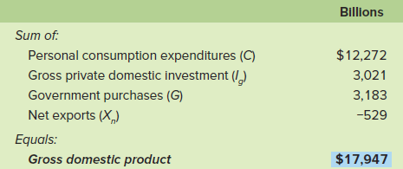
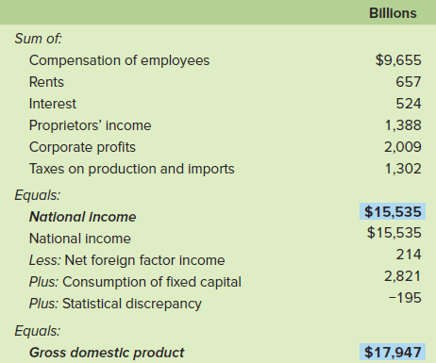
Accounting Statement for the U.S. Economy, 2015
LO2
Notes:
This table calculates GDP for 2015 in the United States by both the expenditures approach and the income approach. Note that both methods come to the same total of GDP for the year.

Slide 14
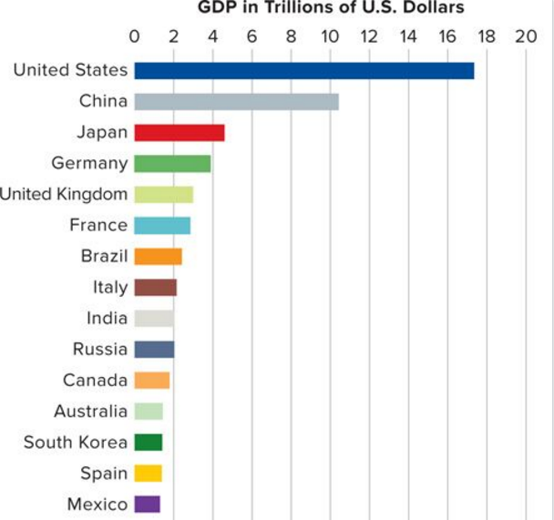
Comparative GDP
LO2
Notes:
In this table comparing GDPs for selected nations for 2014, the United States, China, and Japan have the world’s highest GDP. Note that all data have been converted to U.S. dollars via international exchange rates.

Slide 15
The Income Approach
Compensation of employees
Rents
Interest
Proprietor’s income
Corporate profits
Corporate income taxes
Dividends
Undistributed corporate profits
Taxes on production and imports
LO3
Notes:
This approach allocates expenditures as income to those responsible for producing the output. The major component is national income, which is made up of employee compensation, rents, interest, proprietor’s income, corporate profits, and taxes on production and imports. The largest share is employee compensation which includes wages and salaries paid by both businesses and government as well as supplements such as benefits paid by employers on behalf of employees.

Slide 16
The Income Approach Continued
From national income to GDP
Subtract net foreign factor income
Statistical discrepancy
Consumption of fixed capital
Other national accounts
Net domestic product (NDP)
National income (NI)
Personal income (PI)
Disposable income (DI)
LO3, LO4
Notes:
Under the income approach, all expenditures on final goods and services flow as income to either private citizens or the government. To move from national income to GDP, several adjustments must be made. The first adjustment is for net foreign factor income. This is income Americans gain from supplying resources abroad, which would be taken out, and then income that foreigners gain from supplying resources to the U.S. would be added.
The next adjustment comes from what is called a statistical discrepancy, which basically is just a balancing amount. The final adjustment factor is the useful life of private capital equipment that extends well beyond the year in which they were produced. The cost of the equipment must be allocated over its useful life. The other national accounts provide useful information about the economy’s performance.
NDP is GDP less consumption of fixed capital. National income is NDP less the statistical discrepancy and plus the net foreign factor income. Personal income includes all income received, regardless of whether it is earned or unearned. Finally, disposable income is PI less personal taxes.

Slide 17
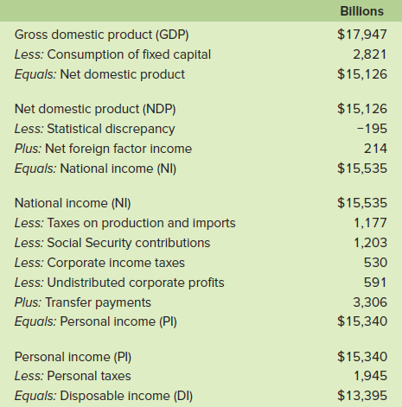
U.S. Income Relationships 2015
LO4
Notes:
These tables illustrate the relationship between GDP, NDP, NI, PI, and DI in the United States for 2015.

Slide 18
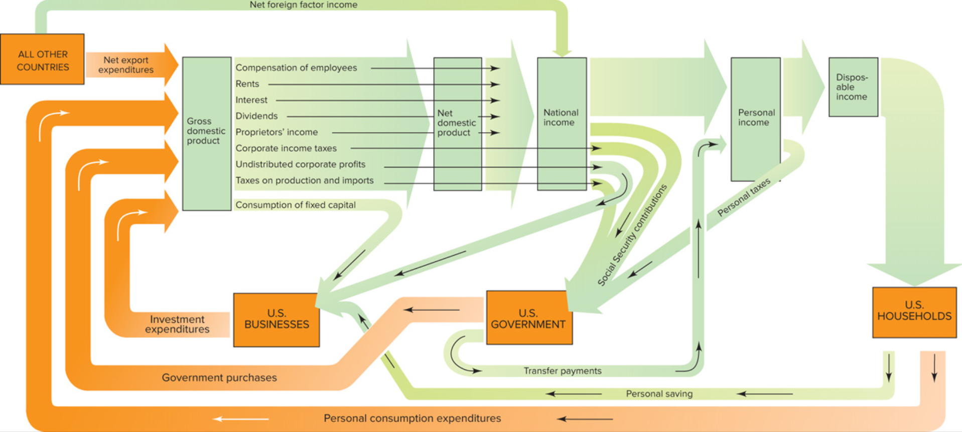
Circular Flow Revisited
LO4
Notes:
Here is the updated circular flow that was introduced in a much simpler form in a previous chapter. However, from this diagram, we can see that even when we account for more transactions in the economy, income and expenditures are equal.

Slide 19
Nominal GDP vs. Real GDP
GDP is a dollar measure of production
Using dollar values creates problems
Nominal GDP
Based on prices that prevailed when output was produced
Real GDP
Reflect changes in the price level
Use base year price
LO5
Notes:
GDP measures production at current dollar values which creates problems because the value of a dollar changes over time. One hundred years ago, the purchasing power of one dollar was much different than it is today. To get around that problem, there are two different GDPs. Nominal GDP is based upon the prices that were in effect when the output was produced. A GDP that has been deflated or inflated to reflect changes in price levels is referred to as real GDP. In order to calculate real GDP, a base year must be selected and then the current year’s prices adjusted accordingly.

Slide 20
GDP Price Index
Use price index to determine real GDP
Price
Index
In Given
Year
Price of Market Basket
in Specific Year
=
×
100
Price of Same Basket
in Base Year
Nominal GDP
Real
GDP
=
Price Index (in hundredths)
LO5
Notes:
This is the formula used to calculate real GDP. We use a price index that is equal to the price of a collection of goods and services in the specific year divided by the price for the same goods and services in a base year multiplied by 100. Nominal GDP is then divided by the price index (in hundredths) to determine real GDP.

Slide 21
GDP Price Index Continued
Calculating Real GDP (Base Year = Year 1)
Year | (1) Units of Output | (2) Price of Pizza Per Unit | (3) Price Index (Year 1 = 100) | (4) Unadjusted, or Nominal, GDP (1) × (2) | (5) Adjusted, or Real, GDP
1 | 5 | $10 | 100 | $ 50 | $50
2 | 7 | 20 | 200 | 140 | 70
3 | 8 | 25 | 250 | 200 | 80
4 | 10 | 30 | --- | --- | ---
5 | 11 | 28 | --- | --- | ---
LO5
Notes:
In this table, nominal GDP and real GDP are calculated based upon the formula. Years 1 to 3 have been calculated. Complete the table for years 4 and 5.

Slide 22
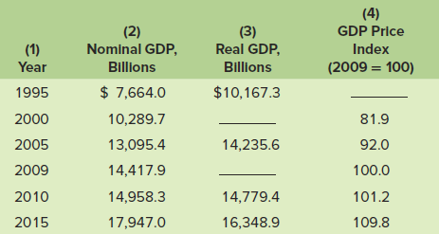
Real World Considerations
Notes:
This table shows some of the relationships between nominal GDP, real GDP and the GDP price index over the past decade. Here the base year is 2009 (note that is the year where the index is 100). To test your understanding of the relationships, determine the value of the price index for 1995 and real GDP for 2005 and 2009.

Slide 23
Shortcomings of GDP
Nonmarket activities
Leisure
Improved product quality
The underground economy
GDP and the environment
Composition and distribution of output
Noneconomic sources of well-being
LO6
Notes:
While GDP is a reasonably accurate and highly useful measure of how the economy is performing, it does have several shortcomings. Certain productive activities occur outside of any market and therefore are not measured in the traditional way. The value of leisure time, weekends, holidays, etc., is also not included, but they certainly add value due to the added satisfaction they provide to workers.
GDP fails to capture the full value of improvements in product quality. Let’s face it, a $200 cell phone purchased today is of very different quality than a cell phone that cost $200 just a decade ago. There is also a huge underground economy, mainly comprised of illegal activities, that produces income that is not measured through traditional GDP methods. Included in this underground economy are legal activities that provide income that the recipients refuse to report to the I.R.S. and pay taxes on. Environmental issues and noneconomic sources of well-being are also problematic in that GDP does not really have a way to accurately value and report the issues.

Slide 24
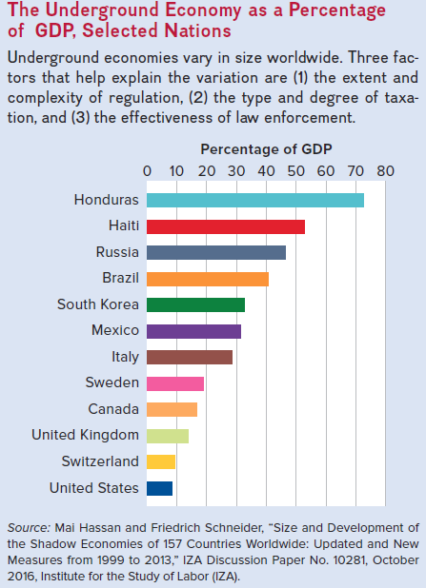
Underground Economy
LO6
Notes:
This table shows the underground economy as a percentage of GDP in several nations. Three factors that help explain the variation in size are (1) the extent and complexity of regulation, (2) the type and degree of taxation, and (3) the effectiveness of law enforcement.

Slide 25
Gross Output
Sum of
Resource Extraction
Production
Distribution
Final Output (GDP)
Larger than GDP
Better reflection of productive side of economy
LO6
Notes:
Gross output (GO) is a statistic that sums together the dollar value of the economic activity that takes place at each stage into which all economic activity can be grouped. In 2015, GO was $31.5 trillion while GDP was $17.9 trillion. GO is particularly useful when attempting to gauge the magnitude of business cycle fluctuations. During the 2007-2009 recession, real GDP fell 4.2%, while real GO fell 8.6%. That means total economic activity fell by more than twice as much as final output which helps to explain why employment fell so dramatically during and after the Great Recession.

Slide 26
Sources of BEA Data
Consumption
Census Bureau’s Retail Trade Survey
Census Bureau’s Survey of Manufacturers
Census Bureau’s Service Survey
Industry trade sources
Notes:
The Bureau of Economic Analysis, an agency of the Department of Commerce, is responsible for compiling the NIPA tables. The BEA gets its data from a variety of sources. The consumption data comes from four primary sources, three of which are provided by the Census Bureau. The Retail Trade Survey gathers sales data from a sample of 22,000 firms, the Survey of Manufacturers collects information on shipments of consumer goods from 50,000 establishments, and the Service Survey collects sales data from 30,000 service businesses. The BEA also collects information from a variety of industry trade sources.

Slide 27
Sources of BEA Data Continued
Investment
All consumption data sources
Census Bureau’s Housing Starts Survey and Housing Sales Survey
Retail Trade Survey
Wholesale Trade Survey
Survey of Manufacturing
Notes:
For investment data, the BEA looks at the consumption sources as well as the Housing Starts Survey and Housing Sales Survey produced by the Census Bureau.

Slide 28
Sources of BEA Data Concluded
Government Purchases
Office of Personnel Management
Construction surveys
Census Bureau’s Survey of Government Finance
Net Exports
U.S. Customs Service
BEA surveys and analysis
Notes:
The data for government purchases comes from the Office of Personnel Management, OPM, which collects data on wages and benefits of both public and private sectors, and the Construction Survey and the Census Bureau’s Survey of Government Finance, which provide data on government consumption and investment expenditures. The Net Exports data comes from U.S. Customs Service reports and the BEA surveys of domestic exporters and importers of services.

