Slide 1

Time Series and Forecasting
Chapter 18

Slide 2
Learning Objectives
LO18-1 Define and describe the components of a time series.
LO18-2 Smooth a time series by computing a moving average.
LO18-3 Smooth a time series by computing a weighted moving average.
LO18-4 Use regression analysis to fit a linear trend line to a time series.
LO18-5 Use regression analysis to fit a nonlinear time series.
LO18-6 Compute and apply seasonal indexes to make seasonally adjusted forecasts.
LO18-7 Deseasonalize a time series using seasonal indexes.
LO18-8 Conduct a hypothesis test of autocorrelation.

Slide 3
Time Series and its Components
LO18-1 Define and describe the components of a time series.
A TIME SERIES is a collection of data recorded over a period of time (weekly, monthly, or quarterly), that can be used by management to compute forecasts as input to planning and decision making. It usually assumes past patterns will continue into the future.
Components of a Time Series
Secular Trend – the smooth long term direction of a time series
Cyclical Variation – the rise and fall of a time series over periods longer than one year
Seasonal Variation – Patterns of change in a time series within a year which tends to repeat each year
Irregular Variation – classified into:
  Episodic – unpredictable but identifiable
  Residual – also called chance fluctuation and unidentifiable

Slide 4
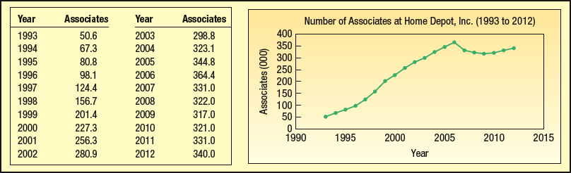
Secular Trend – Example
LO18-1

Slide 5
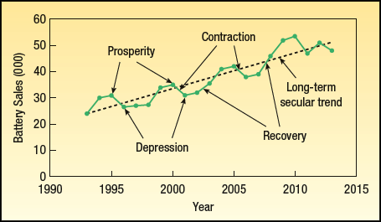
Cyclical Variation – Sample Chart
LO18-1

Slide 6
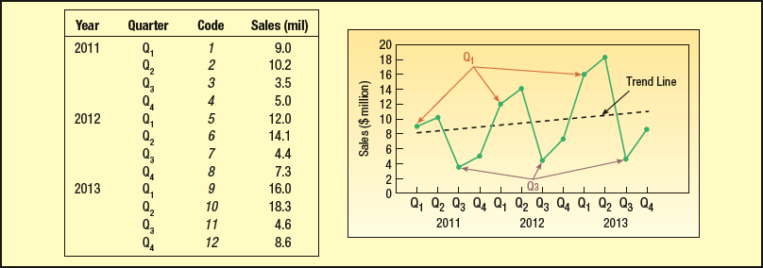
Seasonal Variation – Sample Chart
LO18-1

Slide 7
Irregular variation
LO18-1
Behavior of a time series other than trend cycle or seasonal.
Subdivided into:
  Episodic.
  Residual.
Also known as forecasting error.

Slide 8
The Moving Average Method
LO18-2 Smooth a time series by computing a moving average.
Useful in smoothing time series to see its trend.
Basic method used in measuring seasonal fluctuation.
Applicable when a time series follows a fairly linear trend.

Slide 9
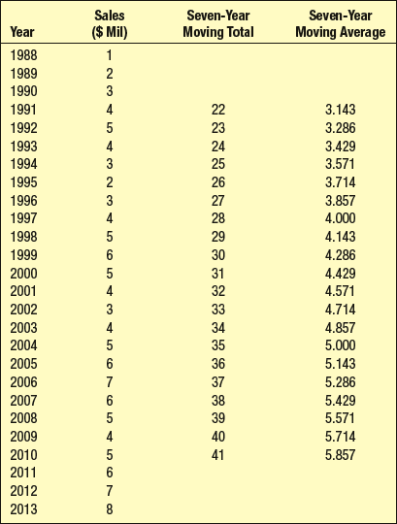
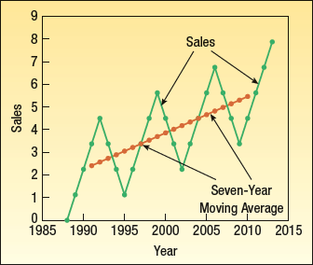
Moving Average Method - Example
LO18-2

Slide 10
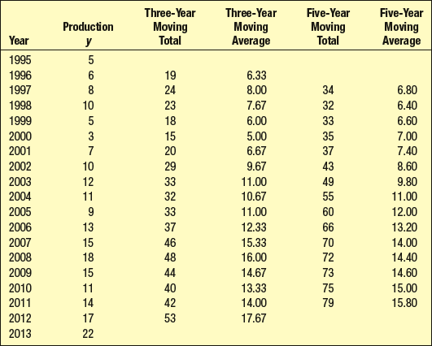
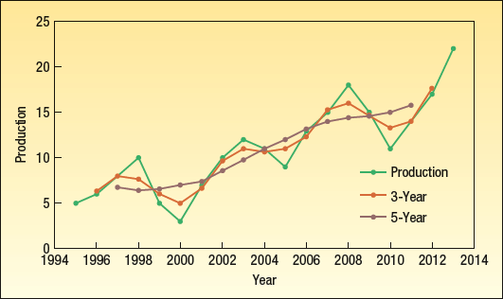
3-year and 5-Year Moving Averages:
Example
LO18-2

Slide 11
Weighted Moving Average
LO18-3 Smooth a time series by computing a weighted moving average.
A simple moving average assigns the same weight to each observation in the averages.
Weighted moving average assigns different weights to each observation in the average.
Most recent observations receive the most weight, and the weight decreases for older data values.
We assign the weights so that the sum of the weights = 1.

Slide 12
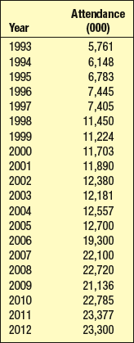
Weighted Moving Average - Example
LO18-3
Cedar Fair operates seven amusement parks and five separately gated water parks. Its combined attendance (in thousands) for the last 20 years is given in the following table. A partner asks you to study the trend in attendance. Compute a three-year moving average and a three-year weighted moving average with weights of 0.2, 0.3, and 0.5 for successive years.

Slide 13
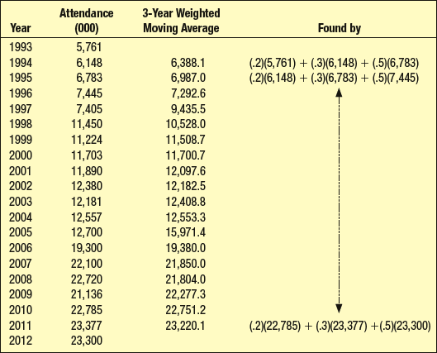
Smoothing with a Weighted Moving Average - Example
LO18-3

Slide 14
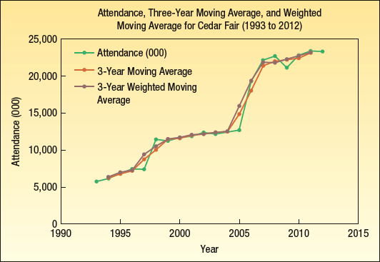
Smoothing with a Weighted Moving Average - Example
LO18-3

Slide 15
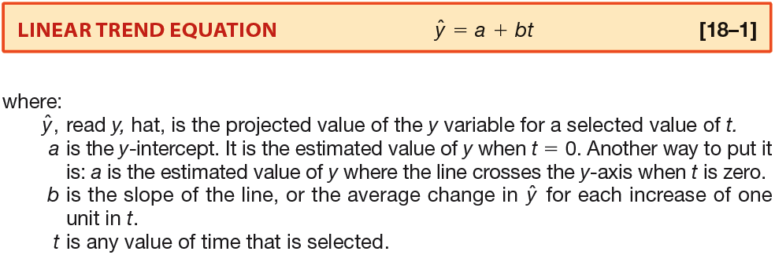
Linear Trend
LO18-4 Use regression analysis to fit a linear trend line to a time series
The long term trend of a time series may approximate a straight line.

Slide 16
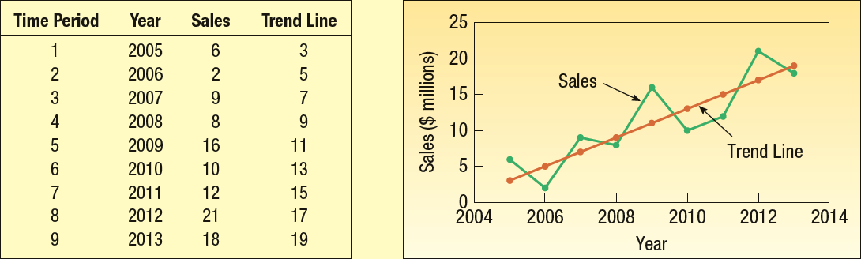
Linear Trend Plot
LO18-4

Slide 17
Linear Trend – Using the Least Squares Method, Regression Analysis, and Excel
LO18-4
Use the least squares method in Simple Linear Regression (Chapter 13) to find the best linear relationship between 2 variables
Code time (t) and use it as the independent variable. That is, let t be 1 for the first year, 2 for the second, and so on.

Slide 18
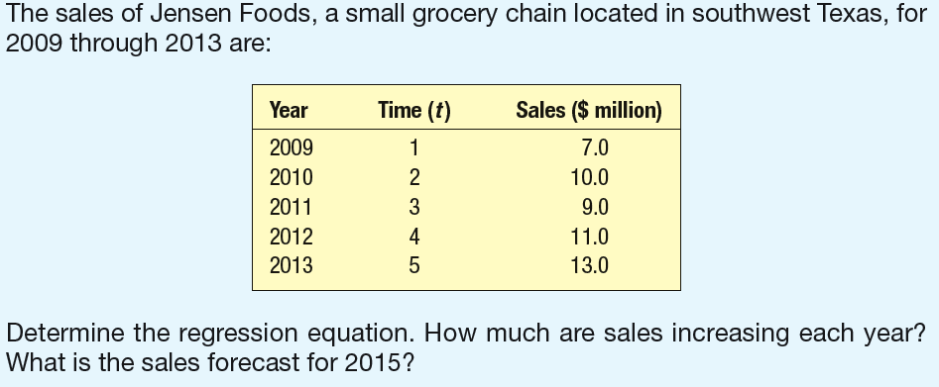
LO18-4
Linear Trend – Using the Least Squares Method, Regression Analysis, and Excel

Slide 19
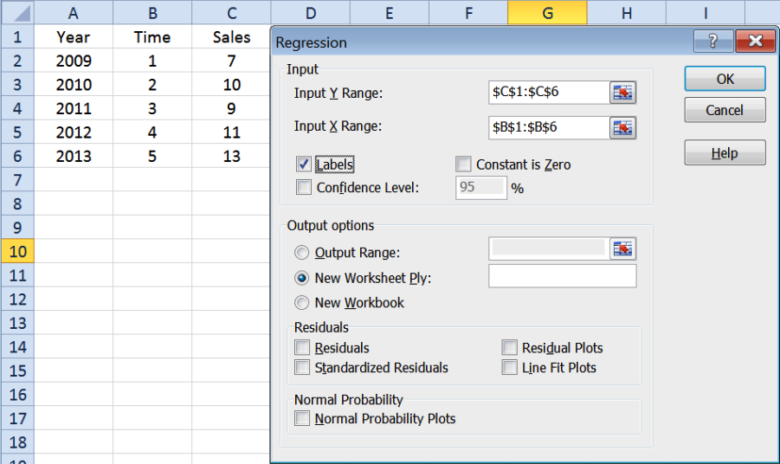
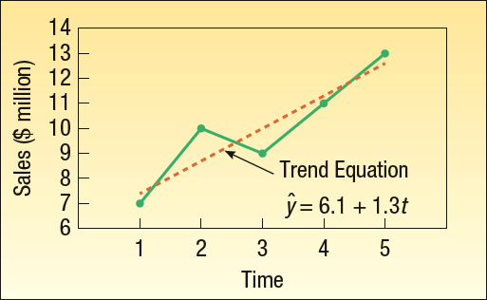
Linear Trend – Using the Least Squares Method, Regression Analysis, and Excel
LO18-4

Slide 20
Nonlinear Trend – Using Regression Analysis and Excel
LO18-5 Use regression analysis to fit a nonlinear time series.
A linear trend equation is used when the data are increasing (or decreasing) by equal amounts.
A nonlinear trend equation is used when the data are increasing (or decreasing) by increasing amounts over time.
When data increase (or decrease) by equal percents or proportions a scatter plot will show a nonlinear pattern.

Slide 21
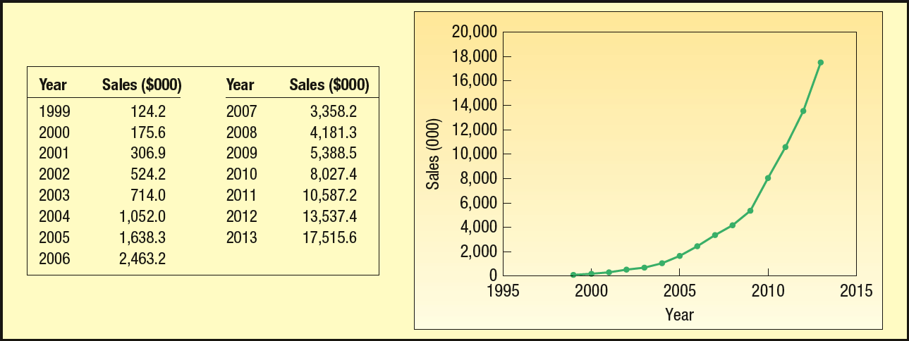
LO18-5
Nonlinear Trend – Using Regression Analysis, an Excel Example
Must transform the data to create a linear relationship. We will convert the data using log function as follows:

Slide 22
Nonlinear Trend – Using Regression Analysis, an Excel Example
LO18-5

Slide 23
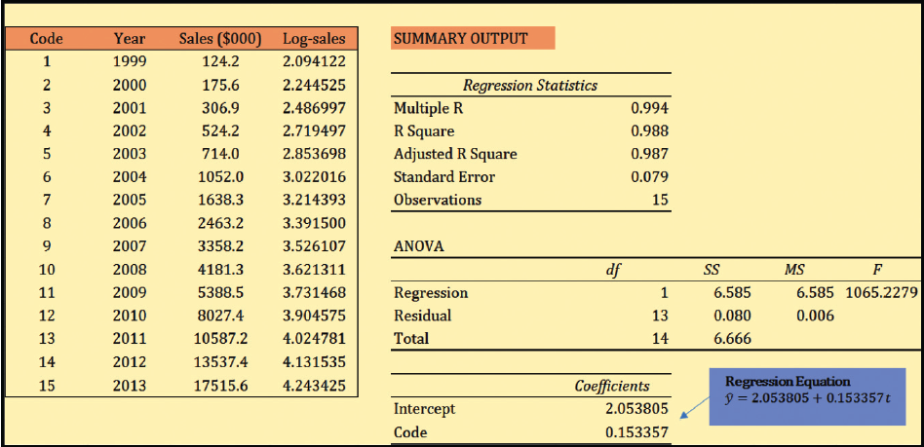
Nonlinear Trend – Using Regression Analysis, an Excel Example
LO18-5
Notes:
.

Slide 24
Nonlinear Trend – Using Regression Analysis, an Excel Example
LO18-5

Slide 25
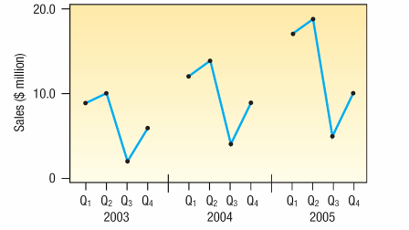
Seasonal Variation
LO18-6 Compute and apply seasonal indexes to make seasonally adjusted forecasts.
One of the components of a time series.
Seasonal variations are fluctuations that coincide with certain seasons and are repeated year after year.
Understanding seasonal fluctuations help plan for sufficient goods and materials on hand to meet varying seasonal demand.
Analysis of seasonal fluctuations over a period of years help in evaluating current sales.

Slide 26
Seasonal Variation – Computing Seasonal Indexes
LO18-6
A number, usually expressed in percent, that expresses the relative value of a season with respect to the average for the year.
Ratio-to-moving-average method.
  The method most commonly used to compute the typical seasonal pattern.
  It eliminates the trend (T), cyclical (C), and irregular (I) components from the time series.

Slide 27
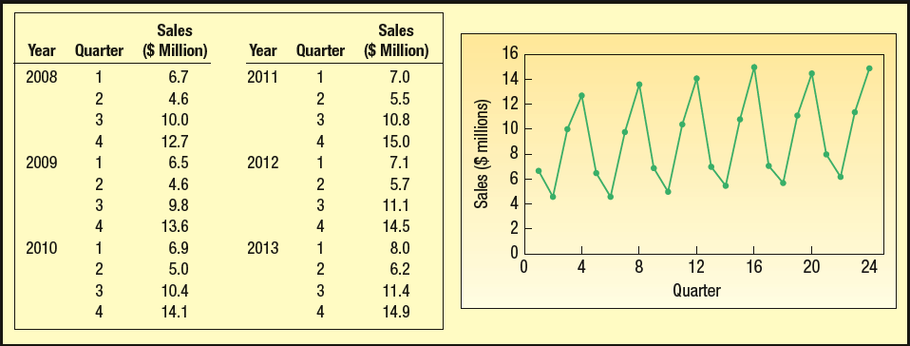
LO18-6
Seasonal Variation – Computing Seasonal Indexes– Example
The table below shows the quarterly sales for Toys International for the years 2001 through 2006. The sales are reported in millions of dollars. Determine a quarterly seasonal index using the ratio-to-moving-average method.

Slide 28
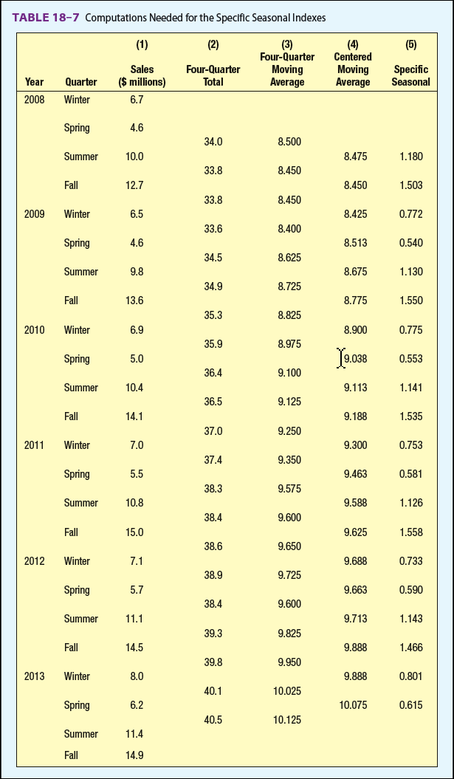
LO18-6
Seasonal Index: using the ratio-to-moving-average method.
Step (1) – Organize time series data in column form.
Step (2) Compute the 4-quarter moving totals.
Step (3) Compute the 4-quarter moving averages.
Step (4) Compute the centered moving averages by getting the average of two 4-quarter moving averages.
Step (5) Compute ratio by dividing actual sales by the centered moving averages.

Slide 29
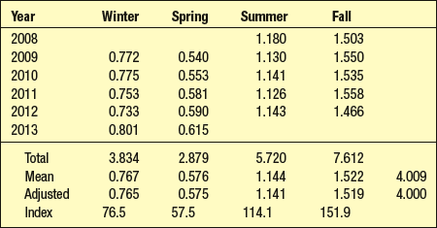
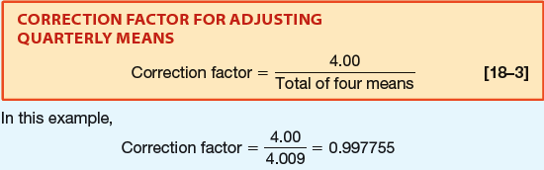
Seasonal Variation – Computing Seasonal Indexes– Example
LO18-6
List all the specific seasonal indexes for each season and average the specific indexes to compute a single seasonal index for each season.
The indexes should sum to 4.0 because there are four seasons.
A correction factor is used to adjust each seasonal index so that they add to 4.0.

Slide 30
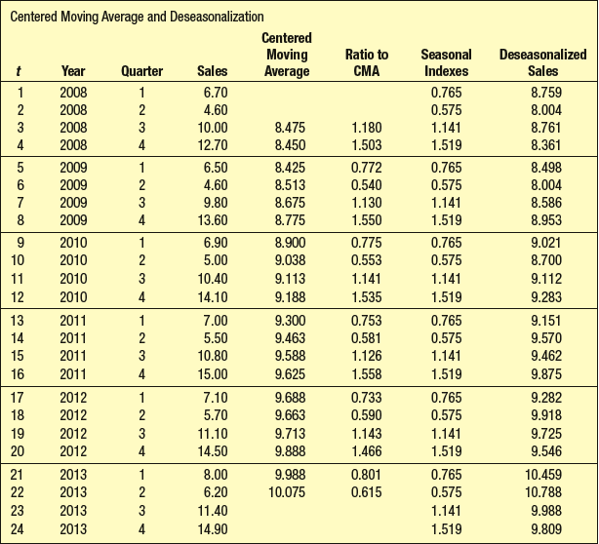
Seasonal indexes can be used to “de-seasonalize” a time series.
LO18-7 Deseasonalize a time series using seasonal indexes.
Deseasonalized Sales = Sales / Seasonal Index

Slide 31
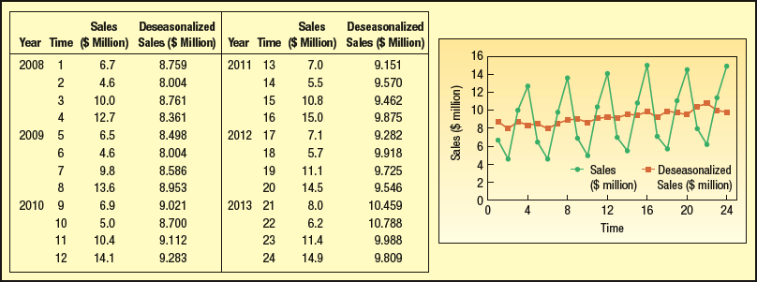
Seasonal indexes can be used to “de-seasonalize” a time series and find the underlying trend component.
LO18-7
To find the trend component of the time series, run a regression analysis of:
deseasonalized sales = a + b(time).
The result is:
Deseasonalized sales = 8.11043 + .08988(time)

Slide 32
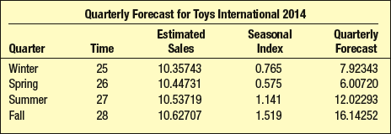
Computing seasonally adjusted trend forecasts
LO18-7
Given the deseasonalized linear equation for Toys International sales as:
Deseasonalized sales = 8.11043 + .08988(time)
Compute the Deseasonalized (estimated) sales.
Multiply the Estimated sales by the seasonal index.
The result is the quarterly forecast.

Slide 33
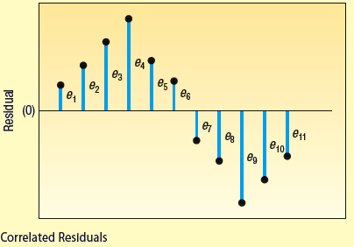
Testing for Autocorrelation: Durbin-Watson Statistic
LO18-8 Conduct a hypothesis test of autocorrelation

Slide 34
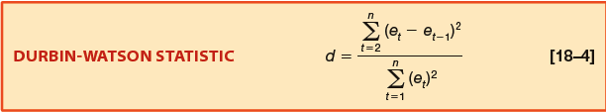
Testing for Autocorrelation: Durbin-Watson Statistic
LO18-8
Tests the autocorrelation among the residuals.
The Durbin-Watson statistic, d, is computed by first determining the residuals for each observation: e_{t} = (Y_{t} – Ŷ_{t}).
Then compute d using the following equation:

Slide 35
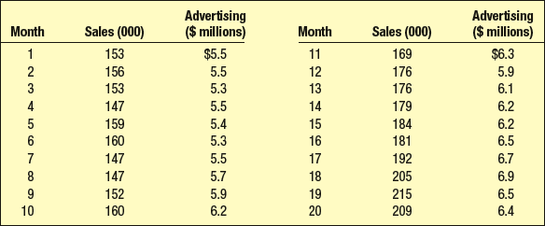
Testing for Autocorrelation: Durbin-Watson Statistic - Example
LO18-8
The Banner Rock Company manufactures and markets its own rocking chair. The company developed special rocker for senior citizens which it advertises extensively on TV. Banner’s market for the special chair is the Carolinas, Florida and Arizona, areas where there are many senior citizens and retired people The president of Banner Rocker is studying the association between his advertising expense (X) and the number of rockers sold over the last 20 months (Y). He collected the following data. He would like to use the model to forecast sales, based on the amount spent on advertising, but is concerned that because he gathered these data over consecutive months that there might be problems of autocorrelation.

Slide 36
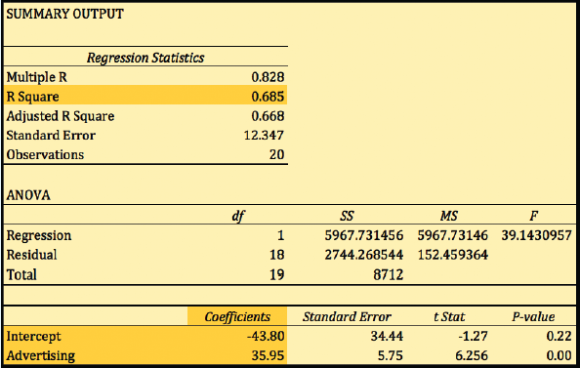
Testing for Autocorrelation: Durbin-Watson Statistic - Example
LO18-8
Step 1: Generate the regression equation

Slide 37
Testing for Autocorrelation: Durbin-Watson Statistic
LO18-8
The resulting equation is: Ŷ = - 43.80 + 35.95X
The correlation coefficient (r) is 0.828
The coefficient of determination (r²) is 68.5%
  (note: Excel reports r² as a ratio. Multiply by 100 to convert into percent)
There is a strong, positive association between sales and advertising.
Is there potential problem with autocorrelation?

Slide 38
Testing for Autocorrelation: Durbin-Watson Statistic
LO15-1
Step 1: State the null hypothesis and the alternate hypothesis.
  H₀: No correlation among the residuals (ρ = 0)
  H₁: There is a positive residual correlation (ρ > 0)
Step 2: Select the level of significance.
We select an α = 0.05.
Step 3: Select the test statistic.
Use the Durbin-Watson d statistic.

Slide 39
Testing for Autocorrelation: Durbin-Watson Statistic
Critical values for d are found in Appendix B.9. For this example:
α - significance level = 0.05
    n – sample size = 20
    K – the number of predictor variables = 1

Slide 40
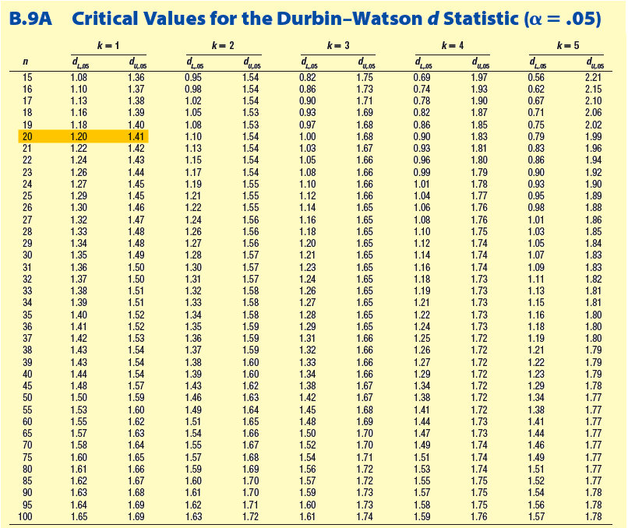
LO18-8
Testing for Autocorrelation: Durbin-Watson Statistic

Slide 41
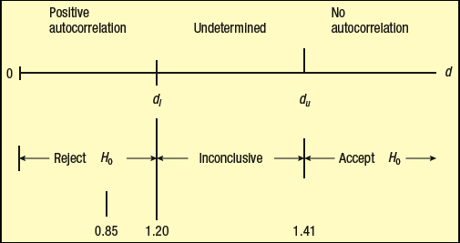
Testing for Autocorrelation: Durbin-Watson Statistic
LO18-8
Step 4: Formulate the decision rule.
  Reject H₀ if d < 1.20, i.e., the residuals are correlated
  Fail to reject H₀ if d > 1.41, i.e., the residuals are not correlated.
  If 1.20 < d < 1.41, then no decision can be made.
Notes:
.

Slide 42
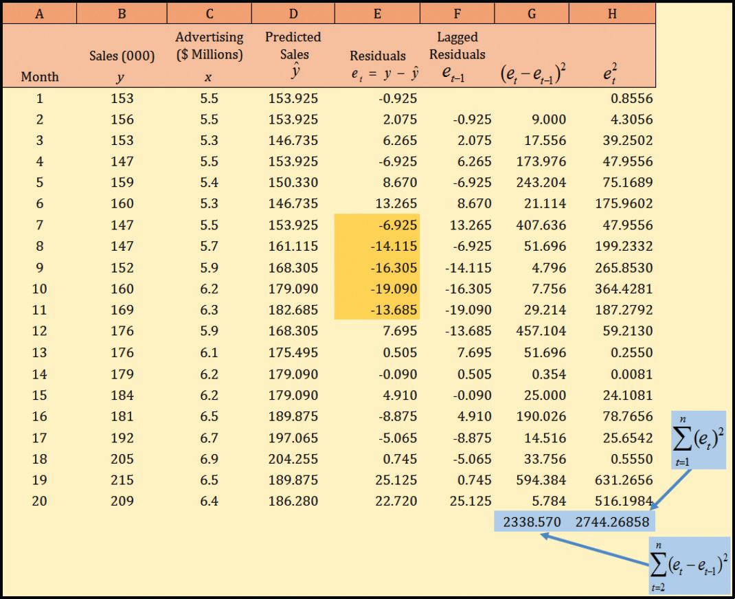
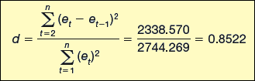
Testing for Autocorrelation: Durbin-Watson Statistic
Step 5: Take a sample, do the analysis, make a decision.
The d statistic is 0.8522 which is less than 1.20. Therefore we reject the null hypothesis and conclude that the observations are correlated and not independent.

Slide 43
Testing for Autocorrelation: Durbin-Watson Statistic
Step 6: Interpret the results. The observations are autocorrelated. A key assumption of regression analysis, the observations are independent and uncorrelated, is not true. Therefore, we cannot make reliable conclusions for any hypothesis tests concerning the significance of the regression equation or the regression coefficients.

