Slide 1
Nonparametric Methods: Analysis of Ordinal Data
Chapter 16

Slide 2
Learning Objectives
LO16-1 Use the sign test to compare two dependent populations.
LO16-2 Test a hypothesis about a median using the sign test.
LO16-3 Test a hypothesis of dependent populations using the Wilcoxon signed-rank test.
LO16-4 Test a hypothesis of independent populations using the Wilcoxon rank-sum test.
LO16-5 Test a hypothesis of several independent populations using the Kruskal-Wallis test.
LO16-6 Test and interpret a nonparametric hypothesis test of correlation.

Slide 3
Nonparametric Tests
No assumption is required about the shape of the population distribution.
Sometimes referred to as distribution free tests.
Require that responses be ranked or ordered.
Responses must be ordinal, interval or ratio scale.
Five Nonparametric Tests:
Sign test.
Median test.
Wilcoxon signed-rank test.
Wilcoxon rank-sum test.
Kruskal-Wallis analysis of variance by ranks.

Slide 4
The Sign Test
LO16-1 Use the sign test to compare two dependent populations.
The Sign Test is used to test for a difference between two dependent or related populations.
The observations are paired based on a common attribute.
No assumption regarding the shape of the population distributions is necessary.
The binomial distribution is the test statistic for small samples and the standard normal (z) for large samples.
Procedure to conduct the test:
Determine the sign (+ or -) of the difference between each pair of observations.
Determine the number of usable pairs.
Count the number “+”s.
We compare the number of “+”s to a critical number determined with the binomial distribution.

Slide 5
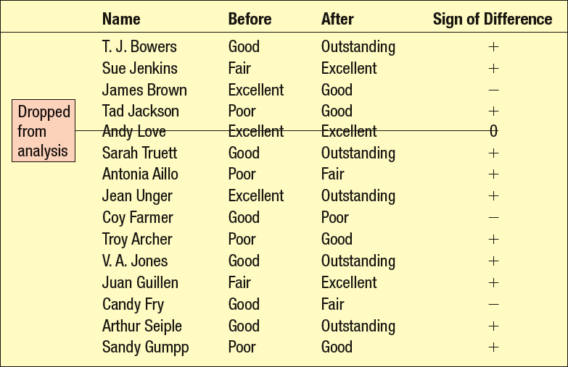
The Sign Test - Example
LO16-1
The director of information systems at Samuelson Chemicals recommended that an in-plant training program be instituted for managers. The objective is to improve the knowledge of database usage in accounting, procurement, and production. 15 managers were randomly selected. Each manager was assessed on their general level of competence using the database. Their competence was rated as outstanding, excellent, good, fair, or poor. After the three-month training program, each manager was rated again. The two ratings (before and after) are shown along with the sign of the difference. A “+” sign indicates improvement, and a “-” sign indicates a decline after the training program.
In preparing the data for the Sign Test, note that any paired observation with no difference is dropped from the analysis. Consequently, there are 14 managers in the sample.
Did the in-plant training program effectively increase the competence of the managers using the company’s database?

Slide 6
The Sign Test - Example
LO16-1
Step 1: State the Null and Alternative Hypotheses.
H₀: π ≤.5 (There is no increase in competence as a result of the in- plant training program.)
H₁: π >.5 (There is an increase in competence as a result of the in- plant training program.)
Step 2: Select a level of significance.
We select the .10 level.
Step 3: Decide on the test statistic.
It is the number of plus signs resulting from the experiment.

Slide 7
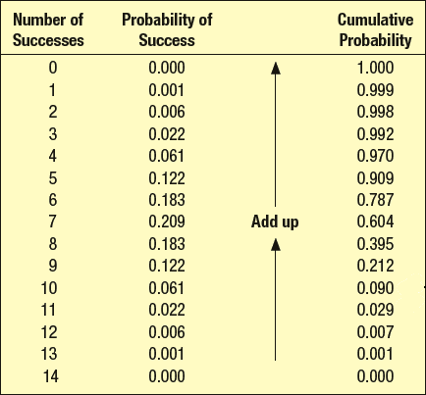
The Sign Test - Example
LO16-1
Step 4: Formulate a decision rule. Based on a binomial distribution with 14 trials and π = .5, the upper, one-tail rejection region with a probability that does not exceed 0.10 is shown below. So, the decision rule is: reject the null hypothesis if the number of “+”s is 10 or more.
Critical Rejection region: If the number of “+”s exceeds 10, then reject the null hypothesis.

Slide 8
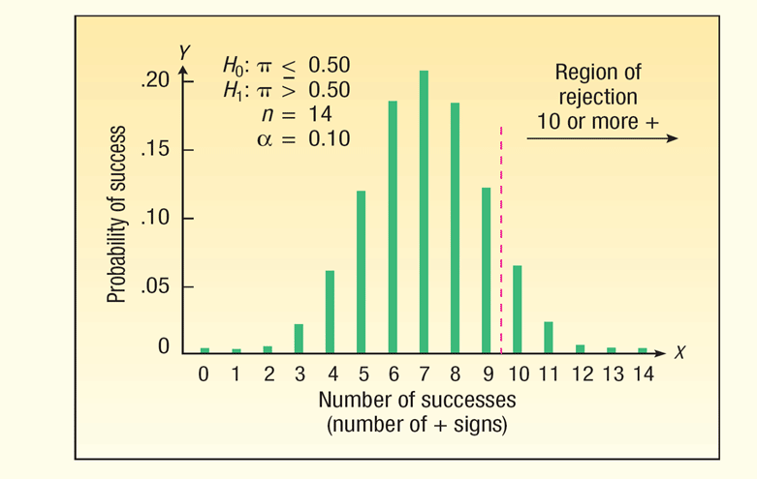
The Sign Test - Example
LO16-1
Step 5: Collect the data, do the analysis, make a decision regarding the null hypothesis.
Eleven out of the 14 managers in the training course increased their database competency. The number 11 is in the rejection region, which starts at 10, so the null hypothesis is rejected.
Step 6: Interpret the results. We conclude that the three-month training course was effective. It increased the competency of the managers.

Slide 9
The Sign Test: Normal Approximation to the Binomial
LO16-1
If the number of observations in the sample is larger than 10, the normal distribution can be used to approximate the binomial. Note that the addition or subtraction to the values of x compensates for using the normal approximation to the binomial.

Slide 10
LO16-1
The Sign Test: Normal Approximation - Example
The market research department of Cola, Inc., has been assigned to test a new soft drink. Two versions of the drink are considered—a rather sweet drink and a somewhat bitter one. A preference test is conducted consisting of a sample of 64 consumers. Each consumer will taste both the sweet cola (labeled A) and the bitter one (labeled B) and indicate a preference.
Conduct a test of hypothesis to determine if there is a difference in the preference for the sweet and bitter tastes. Use the .05 significance level.

Slide 11
LO16-1
The Sign Test: Normal Approximation - Example
Step 1: State the null hypothesis and the alternate hypothesis.
H₀: π = .50 There is no preference
H₁: π ≠ .50 There is a preference
Step 2: Select the level of significance.
α = 0.05 as stated in the problem
Step 3: Select the test statistic.
Use the z-distribution
where µ=.50n and σ=.50

Slide 12
LO16-1
The Sign Test: Normal Approximation - Example
Step 4: Formulate the decision rule.
For a two-tailed hypothesis test with a.05 significance level, the critical z-values are -1.96 and +1.96.
Step 5: Collect a sample, do the analysis, make a decision.
Note: There are 42 pluses. Since 42 is more than n/2 =64/2=32, we use formula (16–2) for z:
The computed z of 2.38 is beyond the critical value of 1.96. We decide to reject the null hypothesis of no difference at the .05 significance level.
Step 6: Interpret the result: The data provide evidence that there is a difference in consumer preference between the two colas. That is, we conclude consumers prefer one cola over another.

Slide 13
The Sign Test: A Hypothesis Test of the Median
LO16-2
For a distribution of a variable, the median is the value in the middle; 50% of the observations are greater than the median, and 50% of the observations are less than the median.
We can use the Sign Test to test a hypothesis about the value of the median. In this analysis, all values less than the hypothesized value of the median are assigned a “-” and all values more than the hypothesized value of the median are assigned a “+”.

Slide 14
The Sign Test: A Hypothesis Test of the Median - Example
LO16-2
The U.S. Bureau of Labor Statistics reported in 2012 that the median amount spent eating out by American families is $2,505 annually. The food editor of the Portland (Oregon) Tribune wishes to know if the citizens of Portland differ from this national value. She selected a random sample of 102 couples and found 60 spent more than $2,505 last year eating out, 40 spent less than $2,505, and surprisingly 2 spent exactly $2,505. At the .10 significance level, is it reasonable to conclude that the median amount spent eating out in Portland, Oregon, is not equal to $2,505?

Slide 15
The Sign Test: A Hypothesis Test of the Median - Example
LO16-2
Step 1: State the Null and Alternative Hypotheses.
H₀: Median = $2505
H₁: Median ≠ $2505
Step 2: Select a level of significance.
We select the .10 level.
Step 3: Decide on the test statistic.
We will use a normal approximation to the binomial distribution because nπ (100*.5 = 50) and ( n(1 - π) = 50) are both greater than 5.

Slide 16
LO16-2
The Sign Test: A Hypothesis Test of the Median - Example
Step 4: Formulate the decision rule.
For a two-tailed hypothesis test with a.10 significance level, the critical z-values are -1.645 and +1.645.
Step 5: Collect a sample, do the analysis, make a decision.
There are 60 pluses. Since 60 is more than n/2 =100/2=50, we use formula 16-2 to calculate z:
The computed z of 1.90 is beyond the critical value of 1.645. We decide to reject the null hypothesis that the median is $2505 at the .10 significance level.
Step 6: Interpret the result: The data provide evidence that the median amount spent eating out is not equal to $2505. From the data, we can observe that the median is probably higher for the Portland, Oregon sample.

Slide 17
Wilcoxon Signed-Rank Test for Dependent Samples
LO16-3 Test a hypothesis of dependent populations using the Wilcoxon signed-rank test.
When we want to test the difference of population means for dependent samples and we cannot assume that the populations are normally distributed, we can use the Wilcoxon Signed-Rank Test.
The data must be measured on the ordinal, interval, or ratio scale of measurement.
Observations must be related or dependent like the paired t-test.
Notes:
.

Slide 18
Wilcoxon Signed-Rank Test for Dependent Samples
LO16-3
The steps for the test are:
Compute the differences between related observations, drop observations with 0 difference from the sample. Make sure to record the signs of the differences.
Rank the absolute value of the differences from low to high.
Return the signs to the ranks and sum positive and negative ranks.
Compare the smaller of the two rank sums with the T value, obtained from Appendix B.8.

Slide 19
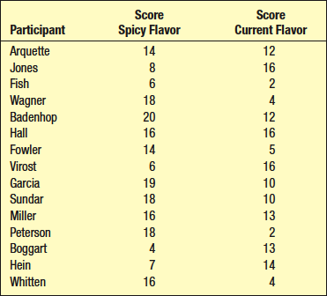
Wilcoxon Signed-Rank Test for Dependent Samples - Example
LO16-3
Fricker’s , a family restaurant, offers a full dinner menu. Its specialty is chicken. Recently, the owner and founder, developed a new spicy flavor for the batter in which the chicken is cooked. Before replacing the current flavor, he wants to conduct some tests to be sure that patrons will like the spicy flavor better. A random sample of 15 customers is chosen, each customer is given a small piece of the current chicken and asked to rate its overall taste on a scale of 1 to 20. A value near 20 indicates the participant liked the flavor, whereas a score near 0 indicates they did not like the flavor. Next, the same 15 participants are given a sample of the new chicken with the spicier flavor and again asked to rate its taste on a scale of 1 to 20.
The results are reported in the table on the right. Is it reasonable to conclude that the spicy flavor is preferred? Use the .05 significance level.

Slide 20
Wilcoxon Signed-Rank Test for Dependent Samples - Example
LO16-3
Step1: State the Hypotheses:
H₀: There is no difference in the ratings of the two flavors.
H₁: The spicy ratings are higher.
Note that this is one-tailed test based on the alternate hypothesis.
Step 2: Select the Level of Significance
It is 0.05.
Step 3: Select the Test Statistic
It is the Wilcoxon T statistic.

Slide 21
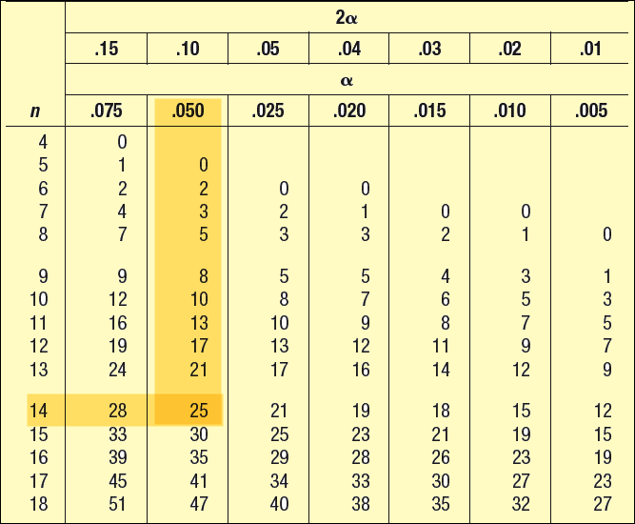
Wilcoxon Signed-Rank Test for Dependent Samples - Example
LO16-3
Step 4: Formulate the Decision Rule.
Reject H₀ if the computed Wilcoxon T statistic is less than the critical T statistic.
The critical values for the Wilcoxon signed-rank test are located in Appendix B.8. A portion of that table is shown on the table to the right. The critical T statistic is found for an alpha of .050 and n=14. The critical T statistic is 25.

Slide 22
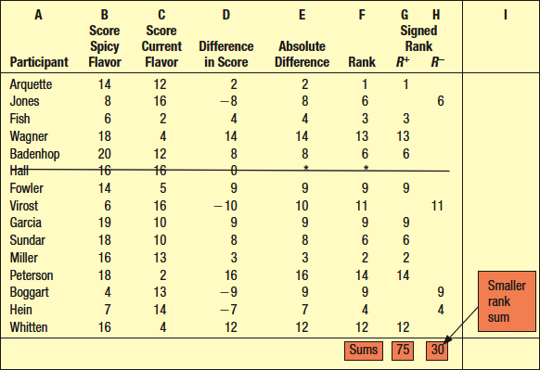
Wilcoxon Signed-Rank Test for Dependent Samples - Example
LO16-3
Step 5: Compute the Test Statistic and Make a Decision.
In this example, the smaller rank sum, 30, is not less than the critical T value of 25. Therefore we fail to reject the null hypothesis.
Step 6: Interpret the Result. The data suggest that we cannot conclude that customers prefer the new spicy flavor over the current flavor.

Slide 23
Wilcoxon Rank-Sum Test for Independent Samples
LO16-4 Test a hypothesis of independent populations using the Wilcoxon rank-sum test.
Used to determine if two independent samples came from the same or equal populations.
No assumption about the shape of the population distribution is required.
The data must be at least ordinal scale.
Each sample must contain at least eight observations.

Slide 24
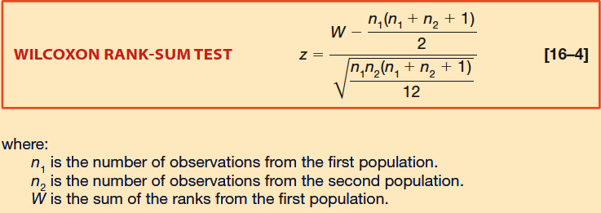
Wilcoxon Rank-Sum Test for Independent Samples
LO16-4
The Wilcoxon rank-sum test is based on the sum of ranks. The data are ranked as if the observations were part of a single sample.
The sum of ranks for each of the two samples is determined
If the null hypothesis is true, then the ranks will be about evenly distributed between the two samples, and the sum of the ranks for the two samples will be about the same.

Slide 25
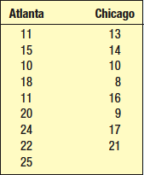
Wilcoxon Rank-Sum Test for Independent Samples - Example
LO16-4
Dan Thompson, the president of CEO Airlines, recently noted an increase in the number of no-shows for flights out of Atlanta. He is particularly interested in determining whether there are more no-shows for flights that originate from Atlanta compared with flights leaving Chicago. A sample of nine flights from Atlanta and eight from Chicago are reported on table.
At the .05 significance level, can we conclude that there are more no-shows for the flights originating in Atlanta?

Slide 26
Wilcoxon Rank-Sum Test for Independent Samples - Example
LO16-4
Step 1: State the Hypotheses.
H₀: The number of no-shows is the same or less for Atlanta and Chicago.
H₁: The number of no-shows is larger for
Atlanta than for Chicago.
Note this is a one-tailed test.
Step 2: Select the Level of Significance.
It is 0.05.
Step 3: Select the Test Statistic.
It is the standard normal z-statistic.
Step 4: Formulate a decision Rule.
Reject H₀ if computed z > critical z.
The critical value of z = 1.645.

Slide 27
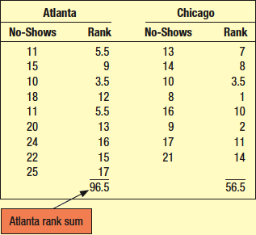
Wilcoxon Rank-Sum Test for Independent Samples - Example
LO16-4
Step 5: Collect the data, do the analysis, make a decision.
Rank the observations from both samples as if they were a single group.
The Chicago flight with only 8 no-shows had the fewest, so it is assigned a rank of 1. The Chicago flight with 9 no-shows is ranked 2, and so on.
Sum the ranks for each city.
We assign the new variable “W” the value of the larger rank sum. So W=96.5.

Slide 28
Wilcoxon Rank-Sum Test for Independent Samples - Example
LO16-4
Step 5: Collect the data, do the analysis, make a decision.
The computed z value (1.49) is less than 1.645. The null hypothesis is not
rejected.
Step 6: Interpret the Result: The data provides evidence that the number of no-shows is not greater in Atlanta.

Slide 29
Kruskal-Wallis Test: Analysis of Variance by Ranks
LO16-5 Test a hypothesis of several independent populations using the Kruskal-Wallis test.
Used to compare three or more samples to determine if they came from equal populations. There are no assumptions about the population distributions.
Data must be measured on an ordinal, interval, or ratio scale.
Alternative to the one-way ANOVA.
Chi-square distribution is the test statistic.
Each sample should have at least five observations.
Data is ranked from low to high as if it were a single group.

Slide 30
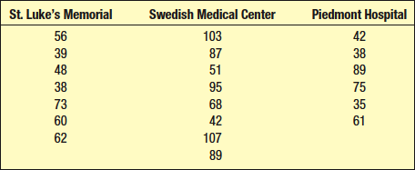
Kruskal-Wallis Test: Analysis of Variance by Ranks - Example
LO16-5
The Hospital System of the Carolinas operates three hospitals in the Greater Charlotte area: St. Luke’s Memorial on the west side of the city, The Swedish Medical Center to the south, and Piedmont Hospital on the east side of town. The Director of Administration is concern about the waiting time of patients with nonlife-threatening athletic type injuries that arrive during weekday evenings at the three hospitals. Specifically, is there a difference in the waiting times at the three hospitals?
The Director selected random samples of patients at the three locations and determined the time, in minutes, between entering the particular facility and when treatment was completed. The times in minutes are reported below.

Slide 31
Kruskal-Wallis Test: Analysis of Variance by Ranks - Example
LO16-5
Step 1: State the hypotheses.
H₀: The population distributions of waiting times are the same for the three hospitals.
H₁: The population distributions of waiting times are NOT all the same for the three hospitals.
Step 2: Select the Level of Significance.
We decide to use 0.05.
Step 3: Select the Test Statistic.
It is the chi-square statistic, with k-1 degrees of freedom, where k is the number of populations. In this case k=3.
Step 4: Formulate a Decision Rule.
H₀ is rejected if the computed Kruskal-Wallis, H, test statistic is greater than the critical value of 5.991. (There are 2 degrees of freedom and the significance level is .05. )

Slide 32
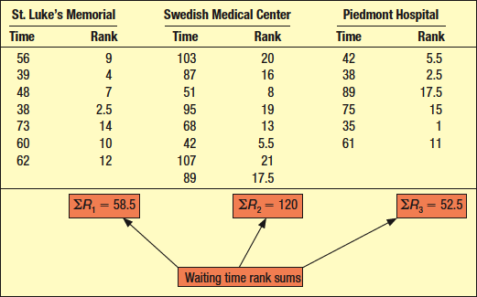
Kruskal-Wallis Test: Analysis of Variance by Ranks - Example
LO16-5
Step 5: Collect the data, do the analysis, make a decision.
Considering the waiting times as a single population, the Piedmont patient with a waiting time of 35 minutes waited the shortest time and hence is given the lowest rank of 1. There are two patients that waited 38 minutes, one at St. Luke’s and one at Piedmont. To resolve this tie, each patient is given a rank of 2.5, found by (2 + 3)/2. This process is continued for all waiting times. The longest waiting time is 107 minutes, and that Swedish Medical Center patient is given a rank of 21. The scores, the ranks, and the sum of the ranks for each of the three hospitals are given in the table below.

Slide 33
Kruskal-Wallis Test: Analysis of Variance by Ranks - Example
LO16-5
Step 5: Collect the data, do the analysis, make a decision.
Because the computed value of the Kruskall-Wallis test statistic, H, (5.38) is less than the critical value of 5.991, the null hypothesis is not rejected.
Step 6: Interpret the result. There is not enough evidence to conclude there is a difference among waiting times at the three hospitals.

Slide 34
Spearman’s Rank-Order Correlation
LO16-6 Test and interpret a nonparametric hypothesis test of correlation.
Spearman’s coefficient of rank correlation reports the association between two sets of ranked observations. The features are:
It can range from –1.00 up to 1.00.
It is similar to Pearson’s coefficient of correlation, but is based on ranked data. As with all nonparametric statistics, Spearman’s correlation coefficient does not require any assumptions about the distribution of the populations.
It is computed using the formula:

Slide 35
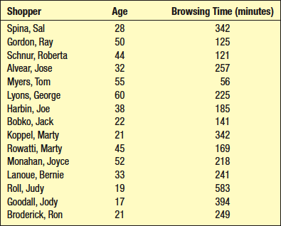
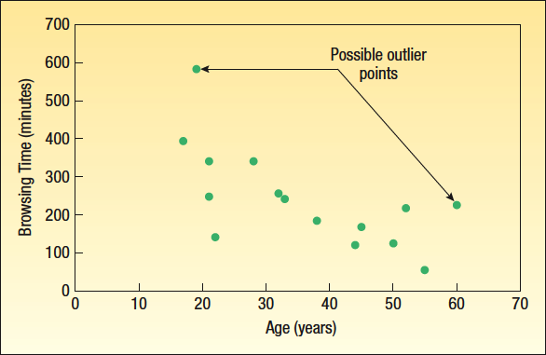
Rank-Order Correlation - Example
LO16-6
Recent studies focus on the relationship between the age of online shoppers and the number of minutes spent browsing on the Internet. The table below shows a sample of 15 online shoppers who actually made a purchase last week. Included is their age and the time, in minutes, spent browsing on the Internet last week.

Slide 36
Rank-Order Correlation - Example
LO16-6
Step 1: State the hypotheses.
H₀: Browsing time and age are not related.
H₁: There is a negative correlation between age and browsing time.
Step 2: Select the Level of Significance.
We decide to use 0.05.
Step 3: Select the Test Statistic.
The test statistic is a t-statistic with n-2, or 15-2=13, degrees of freedom.
Step 4: Formulate a Decision Rule.
H₀ is rejected if the computed t-statistic is less than -1.771.

Slide 37
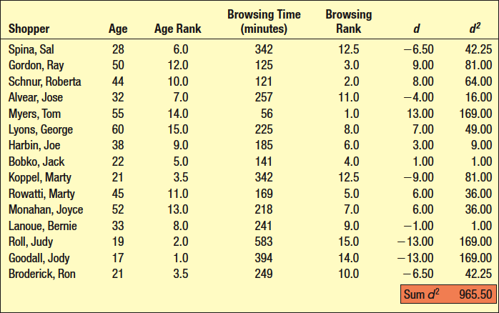
Rank-Order Correlation - Example
LO16-6
Step 5: Collect the data, do the analysis, make a decision.
We rank the ages and rank the browsing times.
We compute the difference, d, between each shoppers age rank and browsing time rank.
We square each difference.
We sum the squared differences to get d^{2.}

Slide 38
Rank-Order Correlation - Example
LO16-6
Step 5: Collect the data, do the analysis, make a decision.
Computer the Spearman’s rank-order correlation coefficient.
The t-value of -3.784 indicates that we can reject the null hypothesis of no relationship between age and browsing time.
Step 6: Interpret the result. The Spearman rank-order correlation coefficient indicates that there is a strong negative, and statistically significant correlation between age and browsing time. The data shows that as age increases, the average browsing time decreases.

