Slide 1

Nonparametric Methods: Nominal Level Hypothesis Tests
Chapter 15

Slide 2
Learning Objectives
LO15-1 Test a hypothesis about a population proportion.
LO15-2 Test a hypothesis about two population proportions.
LO15-3 Test a hypothesis comparing an observed set of frequencies to an expected frequency distribution.
LO15-4 Explain the limitations of using the chi-square statistic in goodness-of-fit tests.
LO15-5 Test a hypothesis that an observed frequency distribution is normally distributed.
LO15-6 Perform a chi-square test for independence on a contingency table.

Slide 3
Testing a Population Proportion
LO15-1 Test a hypothesis about a population proportion.
Recall that when a variable is measured nominally, we can only use statistics based on counts or frequencies.
A way to represent counts or frequencies is with Proportions.
A Proportion is the fraction or percentage that indicates the part of the population or sample having a particular trait of interest.
The sample proportion is denoted by p and is found by x/n.
  x is the number of observations with the particular trait.
  n is the total number of observations.
The population proportion is denoted by π.

Slide 4
Testing a Population Proportion: Assumptions
LO15-1
A random sample is selected from a population that follows the binomial distribution.
The requirements of a binomial distribution (chapter 6) are:
  The data are counts of nominal variables,
  The outcome of each observation is classified into one of two mutually exclusive categories—a “success” or a “failure”,
  The probability of a success is the same for each observed value,
  The observations are independent.
When both nπ and n(1- π ) are at least 5 and the above requirements are met, we can use the normal distribution as an approximation to the binomial distribution to test hypotheses about population proportions.

Slide 5
Testing a Population Proportion - Example
LO15-1
Suppose prior elections in a certain state indicated it is necessary for a candidate for governor to receive at least 80% of the vote in the northern section of the state to be elected. The incumbent governor is interested in assessing his chances of returning to office and plans to conduct a survey of 2,000 registered voters in the northern section of the state. Using the hypothesis-testing procedure, assess the governor’s chances of reelection.

Slide 6
Testing a Population Proportion - Example
LO15-1
Step 1: State the null hypothesis and the alternate hypothesis. Note the keyword in the problem is “at least”, and that a decision to reject the null infers that the governor will not be re-elected.
H₀: π ≥ .80
H₁: π < .80
Step 2: Select the level of significance.
We select an α = 0.05.
Step 3: Select the test statistic.
Use the z-distribution since the assumptions are met:
nπ and n(1-π) ≥ 5.

Slide 7
Testing a Population Proportion - Example
LO15-1
Calculating the z test statistic:
Sample proportion
Hypothesized
population proportion
Sample size

Slide 8
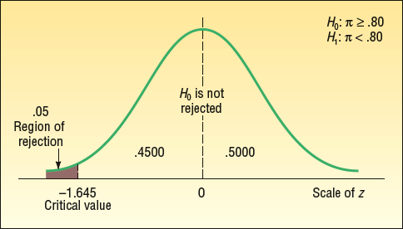
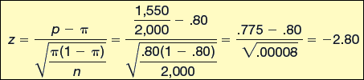
Testing a Population Proportion - Example
LO15-1
Step 4: Formulate the decision rule.
  The hypothesis test is one-tailed so we:
  Reject H₀ if z < -z_{α}
  Reject H₀ if z < -1.645
Step 5: Take a sample, do the analysis, make a decision.
The computed value of z (-2.80) is in the rejection region, so the null hypothesis is rejected at the .05 level.
Step 6: Interpret the results. The difference of 2.5 percentage points between the sample proportion (77.5%) and the hypothesized population proportion (80%) is statistically significant. The evidence at this point does not support the claim that the incumbent governor will return to the governor’s mansion for another four years.
Notes:
.

Slide 9
Two-Sample Tests of Proportions
LO15-2 Test a hypothesis about two population proportions.
EXAMPLES
The vice president of human resources wishes to know whether there is a difference in the proportion of hourly employees who miss more than 5 days of work per year at the Atlanta and the Houston plants.
General Motors is considering a new design for the Chevrolet Camaro. The design is shown to a group of potential buyers under 30 years of age and another group over 60 years of age. Chevrolet wishes to know whether there is a difference in the proportion of the groups who like the new design.
A consultant to the airline industry is investigating the fear of flying among adults. Specifically, the company wishes to know whether there is a difference in the proportion of men versus women who are fearful of flying.

Slide 10

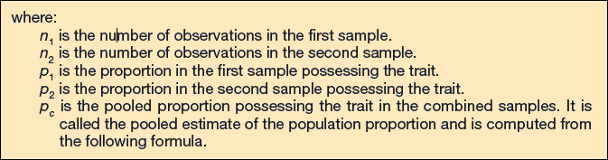
Two-Sample Tests of Proportions
LO15-2
To test hypotheses about the difference between two population proportions, we again use the normal distribution to approximate the binomial distribution.
The z test statistic is computed as:
Notice that the denominator, the standard deviation of (p₁ – p₂), now includes p_{c} which is the “pooled” estimate of the population proportion.

Slide 11

Two-Sample Tests of Proportions
LO15-2
Pooling, or estimating the population proportion.

Slide 12

Two-Sample Tests of Proportions - Example
LO15-2
Manelli Perfume Company recently developed a new fragrance that it plans to market under the name Heavenly. A number of market studies indicate that Heavenly has very good market potential. The Sales Department at Manelli is particularly interested in whether there is a difference in the proportions of younger and older women who would purchase Heavenly if it were marketed. Samples are collected from each of these independent groups. Each woman is asked to smell Heavenly and indicate whether she would purchase the fragrance.

Slide 13
Two-Sample Tests of Proportions - Example
LO15-2
Step 1: State the null and alternate hypotheses.
(keyword: “there is a difference”)
H₀: π₁ = π ₂
H₁: π ₁ ≠ π ₂
Step 2: Select the level of significance.
We select an α = 0.05.
Step 3: Determine the appropriate test statistic.
We will use the z-distribution to approximate the binomial distribution because the sample sizes are relatively large.

Slide 14
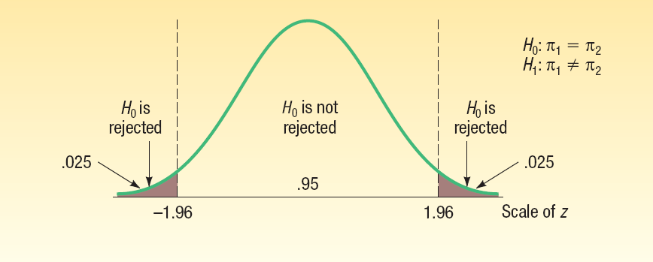
Two Sample Tests of Proportions - Example
LO15-2
Step 4: Formulate the decision rule.
Reject H₀ if z > z_{α/2} or z < - z_{α/2}
z > z_{.05/2} or z < - z_{.05/2}
z > 1.96 or z < -1.96

Slide 15
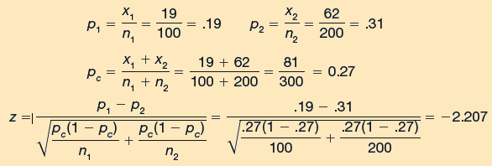
Two Sample Tests of Proportions - Example
LO15-2
Step 5: Select a sample, do the analysis, and make a decision.
Let p₁ equal the proportion of young women who would purchase the fragrance; p₂ equals the proportion of older women who would purchase the fragrance.
The computed value of -2.207 is in the area of rejection. Therefore, the null hypothesis is rejected at the .05 significance level.
Step 6: Interpret the result. The proportions of young and older women who purchase Heavenly are different. By observation, the proportions indicate that older women are more likely to prefer the fragrance.

Slide 16
LO15-3 Test a hypothesis comparing an observed set of frequencies to an expected frequency distribution.
Comparing observed and expected frequency distributions
Hypotheses:
  H₀: There is no difference between observed and expected frequencies. Or, the two frequency distributions are not different.
  H₁: There is a difference between observed and expected frequencies. Or, the two frequency distributions are different.

Slide 17
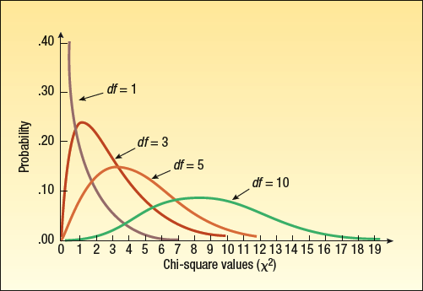
The chi-square statistic is used to test hypotheses comparing frequency distributions.
LO15-3
Comparing observed and expected frequency distributions
The major characteristics of the chi-square distribution:
It is positively skewed.
It is non-negative.
The shape of the distribution depends on its degrees of freedom.

Slide 18
Comparing observed and expected frequency distributions:
The Goodness-of-Fit Test
LO15-3
Let f₀ and f_{e} be the observed and expected frequencies respectively for each category in a frequency distribution. The variable, k, is the number of categories.
The test statistic is:
The value computed inside the brackets for each category is summed for all categories.

Slide 19
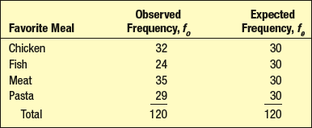
Comparing observed and expected frequency distributions:
The Goodness-of-Fit Test - Example
LO15-3
The Bubba’s Fish and Pasta is a chain of restaurants located along the Gulf Coast of Florida. Bubba, the owner, is considering adding steak to his menu. Before doing so he decides to hire Magnolia Research, LLC, to conduct a survey of adults about their favorite entree when eating out. Magnolia selected a sample of 120 adults and asked each to indicate their entrée when dining out. The results are reported below.
Is it reasonable to conclude there is no preference among the four entrees?
Notice the we computed the expected frequencies so that they are equal (120/4=30). The expected frequency distribution infers that adults have no preference for any of the entrees; the probabilities that an adult would choose any entrée are equal.

Slide 20
Comparing observed and expected frequency distributions:
The Goodness-of-Fit Test - Example
LO15-3
Step 1: State the null hypothesis and the alternate hypothesis.
H₀: There is no difference between the expected and observed frequency distributions of adults selecting each entrée.
H₁: There is a difference between the expected and observed frequency distributions of adults selecting each entrée.
Step 2: Select the level of significance.
α = 0.05 as stated in the problem.
Step 3: Select the test statistic.
The test statistic follows the chi-square distribution,
designated as χ².

Slide 21
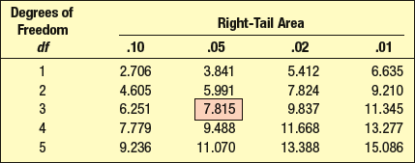
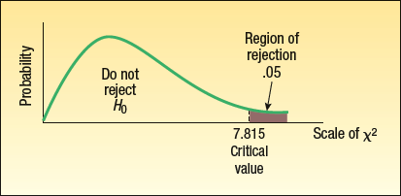
Comparing observed and expected frequency distributions:
The Goodness-of-Fit Test - Example
LO15-3
Step 4: Formulate the decision rule.
The critical value is a chi-square value with (k-1) degrees of freedom, where k is the number of categories. In this example there are 4 categories, so there are (4–1) or 3 degrees of freedom.

Slide 22
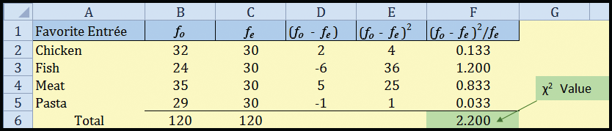
Comparing observed and expected frequency distributions:
The Goodness-of-Fit Test - Example
LO15-3
Step 5: Select a sample, do the analysis, and make a decision.
The computed χ² of 2.20 is less than the critical value of 7.815. The decision, therefore, is to fail to reject H₀ at the .05 level .
Step 6: Interpret the result. The difference between the observed and the expected frequencies is due to chance. There appears to be no difference in the preference among the four entrees.

Slide 23
Comparing observed and expected frequency distributions: The Goodness-of-Fit Test –
Unequal Expected Frequencies Example
LO15-3
The goodness-of-fit test to compare an observed frequency distribution to a frequency distribution of unequal expected frequencies is exactly the same as the procedure for the test with equal frequencies.
Hypotheses:
  H₀: There is no difference between observed and expected frequencies. Or, the two frequency distributions are not different.
  H₁: There is a difference between observed and expected frequencies. Or, the two frequency distributions are different.

Slide 24
Comparing observed and expected frequency distributions: The Goodness-of-Fit Test –
Unequal Expected Frequencies Example
LO15-3
The American Hospital Administrators Association (AHAA) reports the following information concerning the number of times senior citizens are admitted to a hospital during a one-year period. Forty percent are not admitted; 30 percent are admitted once; 20 percent are admitted twice, and the remaining 10 percent are admitted three or more times.
A survey of 150 residents of Bartow Estates, a community devoted to active seniors located in central Florida, revealed 55 residents were not admitted during the last year, 50 were admitted to a hospital once, 32 were admitted twice, and the rest of those in the survey were admitted three or more times.
Can we conclude the survey at Bartow Estates is consistent with the information suggested by the AHAA? Use the .05 significance level.

Slide 25
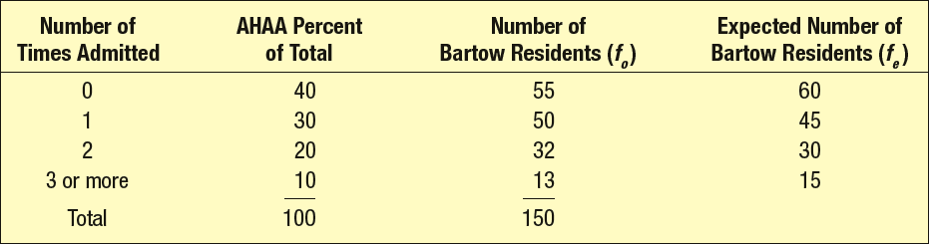
Comparing observed and expected frequency distributions: The Goodness-of-Fit Test –
Unequal Expected Frequencies Example
LO15-3
For this problem, the set of observed frequencies is based on the survey of the 150 residents.
The expected frequencies are computed based on the percentages reported by the AHAA. They say that 40% of seniors are never admitted to a hospital during a year. If this is true, then 40% of the 150 surveyed seniors, or 60 is the expected frequency of this category for the Bartow residents. 30% of seniors are admitted once. So the expected frequency for the Bartow Residents is 30% of the 150 surveyed or 45.

Slide 26
Comparing observed and expected frequency distributions: The Goodness-of-Fit Test – Unequal Expected Frequencies Example
LO15-3
Step 1: State the null hypothesis and the alternate hypothesis.
H₀: There is no difference between the expected and observed frequency distributions of number of times per year senior adults are admitted to a hospital.
H₁: There is a difference between the expected and observed frequency distributions of number of times per year senior adults are admitted to a hospital.
Step 2: Select the level of significance.
α = 0.05 as stated in the problem.
Step 3: Select the test statistic.
The test statistic follows the chi-square distribution,
designated as χ².

Slide 27
Comparing observed and expected frequency distributions: The Goodness-of-Fit Test – Unequal Expected Frequencies Example
LO15-3
Step 4: Formulate the decision rule.
The critical value is a chi-square value with (k-1) degrees of freedom, where k is the number of categories. In this example there are 4 categories, so there are (4–1) or 3 degrees of freedom.

Slide 28
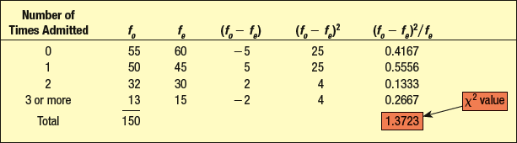
LO15-3
Comparing observed and expected frequency distributions: The Goodness-of-Fit Test – Unequal Expected Frequencies Example
Step 5: Select a sample, do the analysis, and make a decision.
The computed χ² of 1.3723 is less the critical value of 7.815. The decision, therefore, is to fail to reject H₀ at the .05 level .
Step 6: Interpret the result. The difference between the observed and the expected frequencies is due to chance. There appears to be no difference in the distribution of hospital admittance for Bartow Estates Community.

Slide 29
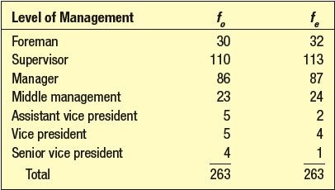
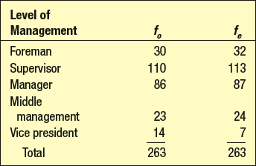
Limitations of the Chi-square Goodness-of-Fit tests
LO15-4 Explain the limitations of using the chi-square statistic in goodness-of-fit tests.
If there is an unusually small expected frequency in a cell, chi-square (if applied) might result in an erroneous conclusion. This can happen because f_{e} appears in the denominator, and dividing by a very small number makes the quotient quite large! Two generally accepted policies regarding small cell frequencies are:
If there are only two cells, the expected frequency in each cell should be at least 5.
2. For more than two cells, chi-square should not be used if more than 20% of the f_{e} cells have expected frequencies less than 5. According to this policy, it would not be appropriate to use the goodness-of-fit test on the following data. Three of the seven cells, or 43%, have expected frequencies (f_{e}) of less than 5.
The issue can be resolved by combining categories if it is logical to do so. In this example, we combine the three vice president categories, which satisfies the
20% policy.

Slide 30
Testing a hypothesis that an observed frequency distribution fits an expected frequency distribution that is normal.
LO15-5 Test a hypothesis that an observed frequency distribution is normally distributed.
To perform this Goodness-of-Fit test, the challenge is to compute the normally distributed set of expected frequencies. To find this distribution, we will use the familiar z-statistic and z-table to find the relative expected frequencies. Then, apply the relative expected frequencies to the total number of observations to compute the expected frequencies, as we did in the Bartow Estates example.
Notes:
.

Slide 31
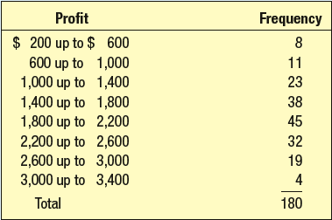
Testing a hypothesis that an observed frequency distribution fits an expected frequency distribution that is normal.
LO15-5
Recall the frequency distribution of Applewood’s profits from the sale of 180 vehicles. The frequency distribution is repeated below.
Is it reasonable to conclude that the observed frequency distribution of profits is normally distributed?
Notes:
.

Slide 32
Testing a hypothesis that an observed frequency distribution fits an expected frequency distribution that is normal.
LO15-5
Step 1: State the null hypothesis and the alternate hypothesis.
H₀: There is no difference between the expected and observed frequency distributions. There is no evidence to conclude that the expected frequency distribution is not normal.
H₁: There is a difference between the expected and observed frequency distributions. The expected observed frequency distributions are different! The observed distribution is not normal.
Step 2: Select the level of significance.
α = 0.05 as stated in the problem.
Step 3: Select the test statistic.
The test statistic follows the chi-square distribution,
designated as χ².

Slide 33
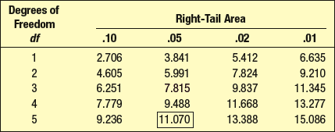
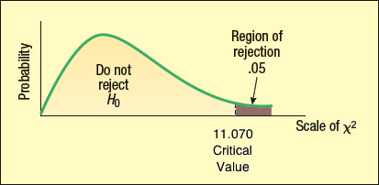
Testing a hypothesis that an observed frequency distribution fits an expected frequency distribution that is normal.
LO15-5
Step 4: Formulate the decision rule.
The critical value is a chi-square value with (k-2-1) degrees of freedom, where k is the number of categories. The “2” represents the two sample statistics (mean and standard deviation) that we will use to compute the normal, expected frequency distribution. In this example there are 8 categories, so there are (8-2-1) or 5 degrees of freedom.

Slide 34


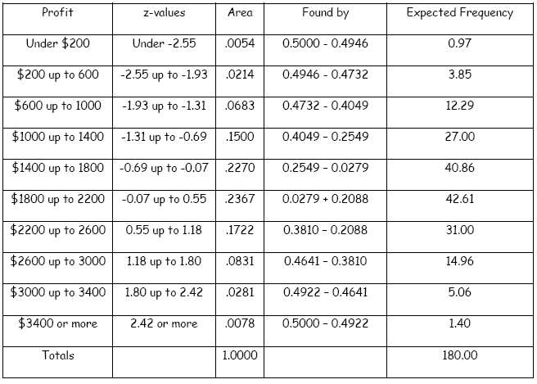
Testing a hypothesis that an observed frequency distribution fits an expected frequency distribution that is normal.
LO15-5
We know from the data that the sample mean profit is $1,843.17 and the sample standard deviation is $643.63.
Convert each class limit into a z-score using the mean of $1,843.17 and standard deviation of $643.63.
Calculate the probabilities for each class based on the z-values for the class limits.

Slide 35
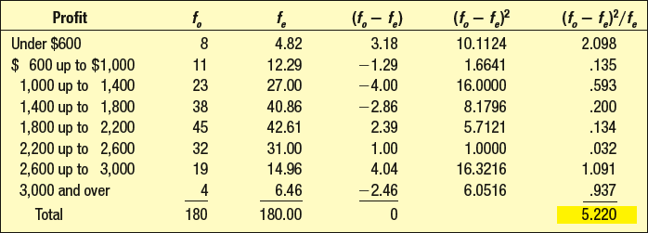
Testing a hypothesis that an observed frequency distribution fits an expected frequency distribution that is normal.
LO15-5
Step 5: Select a sample, do the analysis, and make a decision.
The computed χ² of 5.220 is less the critical value of 11.070. The decision, therefore, is to fail to reject H₀ at the .05 level .
Step 6: Interpret the result. There appears to be no difference between the observed distribution of profits and the expected, normal distribution of profits. We assume that the observed distribution is normally distributed.

Slide 36
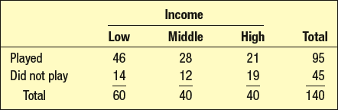
Contingency Table Analysis
LO15-6 Perform a chi-square test for independence on a contingency table.
A contingency table is used to present observed frequencies for two traits or characteristics. Each observation is classified according to two nominally scaled criteria. We are interested to know if there is a relationship between the two variables.
We can analyze a contingency table to determine if a relationship exists between the two variables. For example, we might be interested in the relationship between income level and a person’s decision to play the lottery. The results of a survey of 140 people are illustrated below. Note that the table displays an observed frequency distribution based on two variables.

Slide 37
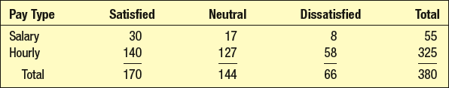
Contingency Table Analysis - Example
LO15-6
Rainbow Chemical, Inc. employs hourly and salaried employees. The vice president of human resources surveyed a random sample of 380 employees about his/her satisfaction level with the current health care benefits program. At the .05 significance level, is it reasonable to conclude that pay type and level of satisfaction with the health care benefits are related?

Slide 38
Contingency Table Analysis - Example
LO15-6
Step 1: State the null hypothesis and the alternate hypothesis.
H₀: There is no relationship between pay type and level of satisfaction with the health care benefits.
H₁: There is a relationship between pay type and level of satisfaction with the health care benefits.
Step 2: Select the level of significance.
α = 0.05 as stated in the problem.
Step 3: Select the test statistic.
The test statistic follows the chi-square distribution, designated as χ².

Slide 39
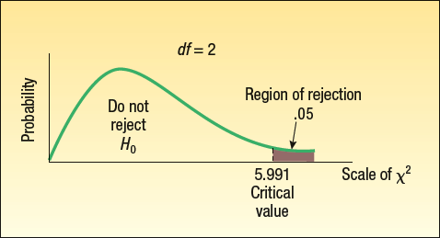
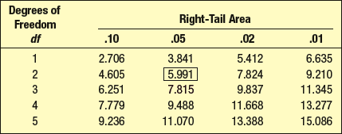
Contingency Table Analysis - Example
LO15-6
Step 4: Formulate the decision rule.
The critical value is a chi-square statistic. The degrees of freedom are: (number of rows – 1)(number of columns – 1). In this example there are 2 rows and 3 columns. So the degrees of freedom are (2-1)(3-1) = (1)(2) is 2.

Slide 40


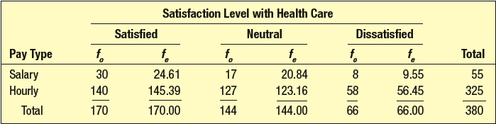
Contingency Table Analysis: Computing Expected Frequencies (f_{e})
LO15-6
For example, the expected frequency for salaried personnel who are satisfied with their health care benefits is:

Slide 41

Contingency Table Analysis - Example
LO15-6
Step 5: Select a sample, do the analysis, and make a decision.
The computed χ² of 2.506 is less the critical value of 5.991. The decision, therefore, is to fail to reject H₀ at the .05 level .
Step 6: Interpret the result. There is no relationship between type of pay and satisfaction with health care benefits.

