Slide 1
Multiple Regression Analysis
Chapter 14

Slide 2
Learning Objectives
LO14-1 Use multiple regression analysis to describe and interpret a relationship between several independent variables and a dependent variable.
LO14-2 Evaluate how well a multiple regression equation fits the data.
LO14-3 Test hypotheses about the relationships inferred by a multiple regression model.
LO14-4 Evaluate the assumptions of multiple regression.
LO14-5 Use and interpret a qualitative, dummy variable in multiple regression.
LO14-6 Include and interpret an interaction effect in multiple regression analysis.
LO14-7 Apply stepwise regression to develop a multiple regression model.
LO14-8 Apply multiple regression techniques to develop a linear model.

Slide 3
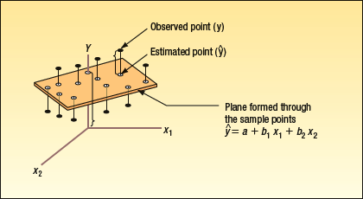
Multiple Regression Analysis
LO14-1 Use multiple regression analysis to describe and interpret a relationship between several independent variables and a dependent variable.
The general multiple regression equation with k independent variables is given by:
X₁ … X_{k} are the independent variables.
a is the y-intercept
b₁ is the net change in Y for each unit change in X₁ holding X₂ … X_{k} constant. It is called a partial regression coefficient or just a regression coefficient.
Determining b₁, b₂, etc. is very tedious. A software package such as Excel or MINITAB is recommended.
The least squares criterion is used to develop this equation.

Slide 4
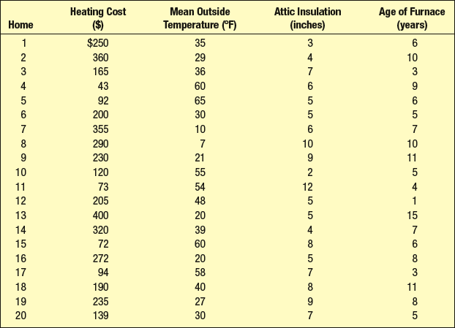
Multiple Regression Analysis- Example
LO14-1
Salsberry Realty sells homes along the east coast of the United States. One of the questions most frequently asked by prospective buyers is: If we purchase this home, how much can we expect to pay to heat it during the winter? The research department at Salsberry has been asked to develop some guidelines regarding heating costs for single-family homes.
Three variables are thought to relate to the heating costs: (1) the mean daily outside temperature, (2) the number of inches of insulation in the attic, and (3) the age in years of the furnace. The Multiple Linear regression equation is:
Heating Cost = a + b₁(Mean Outside Temp) + b₂(Inches of Attic Insulation) + b₃(Age of the Furnace)
To investigate, Salsberry’s research department selected a random sample of 20 recently sold homes and measured all four variables.

Slide 5
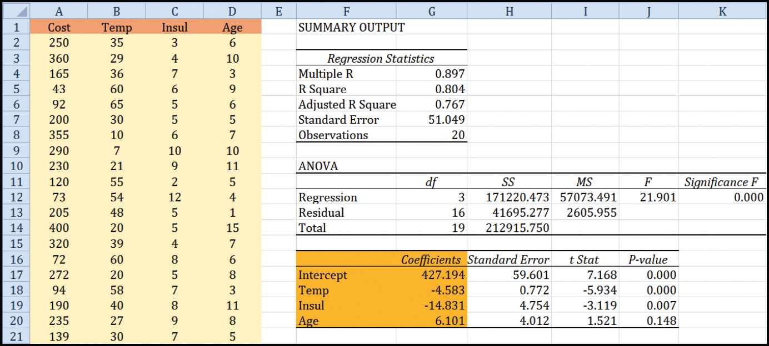
Multiple Regression Analysis– Example: Results from EXCEL
LO14-1
Using the regression coefficients, the multiple regression equation to estimate heating cost is:
Heating Cost = 427.194 – 4.583 (Mean Outside Temp) – 14.831(Inches of Attic Insulation) + 6.101(Age of the Furnace)

Slide 6
Multiple Regression Analysis-Example
LO14-1
Heating Cost = 427.194 – 4.583 (Mean Outside Temp) – 14.831(Inches of Attic Insulation) + 6.101(Age of the Furnace)
Interpreting the Regression Coefficients
The regression coefficient for mean outside temperature, x₁, is 4.583. The coefficient is negative – as the outside temperature increases, the cost to heat the home decreases. For every unit increase in temperature, holding the other two independent variables constant, monthly heating cost is expected to decrease by $4.583 .
The attic insulation variable, x₂, also shows an inverse relationship (negative coefficient). The more insulation in the attic, the less the cost to heat the home. For each additional inch of insulation, the cost to heat the home is expected to decline by $14.83 per month.
The age of the furnace variable shows a direct relationship. With an older furnace, the cost to heat the home increases. For each additional year older the furnace is, the cost is expected to increase by $6.10 per month.

Slide 7
Multiple Regression Analysis – Example: Estimating the Dependent Variable
LO14-1
Heating Cost = 427.194 – 4.583 (Mean Outside Temp) – 14.831(Inches of Attic Insulation) + 6.101(Age of the Furnace)
Applying the Model for Estimation
What is the estimated heating cost for a home if the mean outside temperature is 30 degrees, there are 5 inches of insulation in the attic, and the furnace is 10 years old?
Substituting the values for each of the independent variable, we can calculate the estimated cost to heat the home.
In this case, the predicted cost to heat is $276.56 per month.

Slide 8
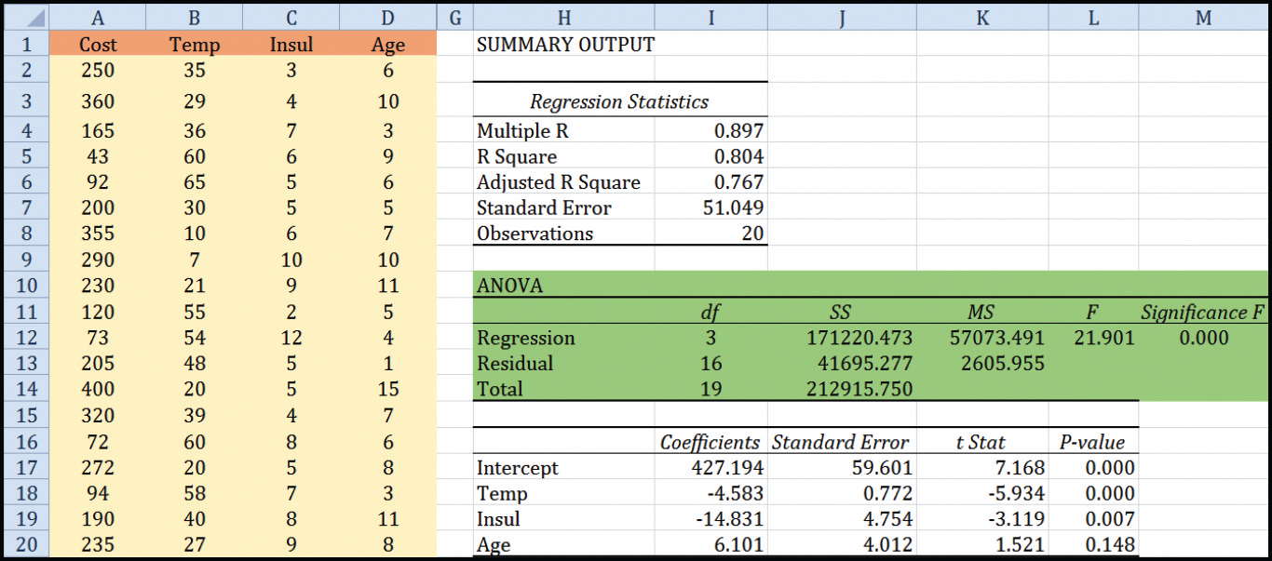
Multiple Regression Analysis: Evaluation – Using the ANOVA Table
LO14-2 Evaluate how well a multiple regression equation fits the data.

Slide 9
Multiple Regression Analysis: Evaluation - Standard Error of Estimate
LO14-2
The multiple standard error of estimate is a measure of the effectiveness of the regression equation.
It is measured in the same units as the dependent variable.
It is difficult to determine what is a large value and what is a small value of the standard error.

Slide 10
Multiple Regression Analysis: Evaluation -Coefficient of Multiple Determination (R²)
LO14-2
The characteristics of the coefficient of multiple determination are:
It is symbolized by a capital R squared. In other words, it is written as R² because it behaves like the square of a correlation coefficient.
It can range from 0 to 1. A value near 0 indicates little association between the set of independent variables and the dependent variable. A value near 1 means a strong association.
It cannot assume negative values. Any number that is squared or raised to the second power cannot be negative.
It is easy to interpret.
Notes:
.

Slide 11
Multiple Regression Analysis: Evaluation -Coefficient of Multiple Determination
LO14-2
We interpret the R² of 0.804 as the percent of variation in heating cost that is explained or accounted for by the three independent variables. Specifically, 80.4% of the variation in heating cost is explained by the three independent variables. The remaining 19.6% is random error and variation from independent variables not included in the equation.

Slide 12
Multiple Regression Analysis: Adjusted Coefficient of Multiple Determination (R²)
LO14-2
Each independent variable added to a multiple regression equation makes the coefficient of determination larger.
In fact, if the number of variables, k, and the sample size, n, are equal, the coefficient of determination will be a “perfect” 1.0. That is a multiple regression equation where k = n will account for 100% of the variation in the dependent variable!
To balance the number of independent variables in a multiple regression equation and the the coefficient of multiple determination, the adjusted R² is used instead.
Notice that the calculation of the adjusted R² includes the regression and total degrees of freedom to compensate for the number of independent variables in the multiple regression equation.
Notes:
.

Slide 13
Multiple Regression Analysis: Evaluation –Adjusted Coefficient of Multiple Determination
LO14-2
We interpret the adjusted R² of 0.767 as the percent of variation in heating cost that is explained or accounted for by the three independent variables. Specifically, 76.7% of the variation in heating cost is explained by the three independent variables. The remaining 23.3% is random error and other independent variables not included in the equation.

Slide 14
Multiple Regression Analysis: The Global Test of the Model
LO14-3 Test hypotheses about the relationships inferred by a multiple regression model.
The global test is used to investigate if any of the independent variables have significant coefficients. That is, if any of the regression coefficients are not equal to zero.
Step 1: State the hypotheses:
Step 2: Decide on a level of significance: α = 0.05
Step 3: Select the appropriate test statistic:
F with k and n-(k+1) degrees of freedom.
Step 4: Formulate a decision rule:
Decision Rule: Reject H₀ if F > F_{α,k,n-(k+1)}

Slide 15
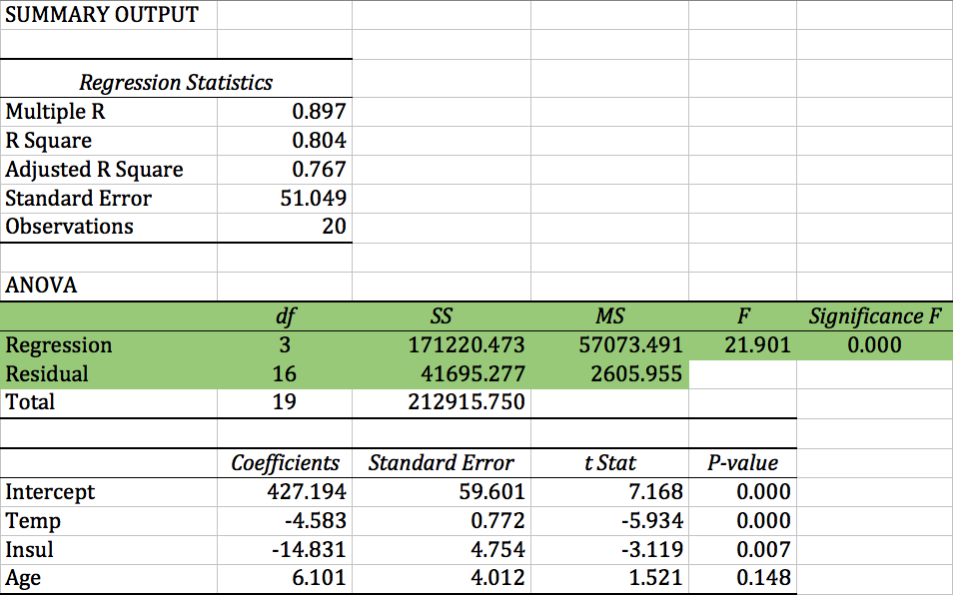
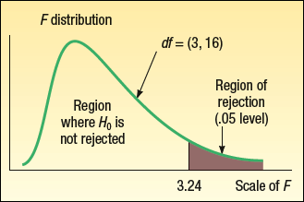
Multiple Regression Analysis: The Global Test of the Model
LO14-3
Step 5: Take a sample, do the analysis, arrive at a decision.
Decision: Based on the F statistic of 21.90 and the p-value of 0.000, reject the null hypothesis.

Slide 16
Multiple Regression Analysis: The Global Test of the Model
LO14-3
Step 6: Interpret the results.
The results of the Global Test of the multiple regression equation show that at least one of the independent variables (mean outside temperature, inches of attic insulation, age of the furnace in years) is related to heating cost. In other words, one or more of the variables explain the variation in the dependent variable, heating cost.
The Global Test is a first analysis of the multiple regression equation. If we failed to reject the null hypothesis, we would stop our analysis of the relationship between the dependent and independent variables with this sample and variables. It is possible that we would attempt a new study designed to predict home heating costs with different independent variables and a new sample of homes.
Instead, our finding of a significant relationship leads us to the next logical question: which independent variables are significantly related to heating cost?

Slide 17
Multiple Regression Analysis: Evaluating Individual Regression Coefficients (β_{i} = 0)
LO14-3
These tests are used to determine which independent variables are significantly related to the dependent variable.
Step 1: State the hypotheses: H₀: β_{i} = 0; H₁: β_{i} ≠ 0
Step 2: Decide on a level of significance: α = 0.05
Step 3: Select the appropriate test statistic:
The test statistic is the t distribution with n-(k+1) degrees of freedom.
Step 4: Formulate a decision rule:
Reject H₀ if t > t_{α/2,n-(k+1)} or t < -t_{α/2,n-(k+1)}
Reject H₀ if t > 2.120 or t < -2.120

Slide 18
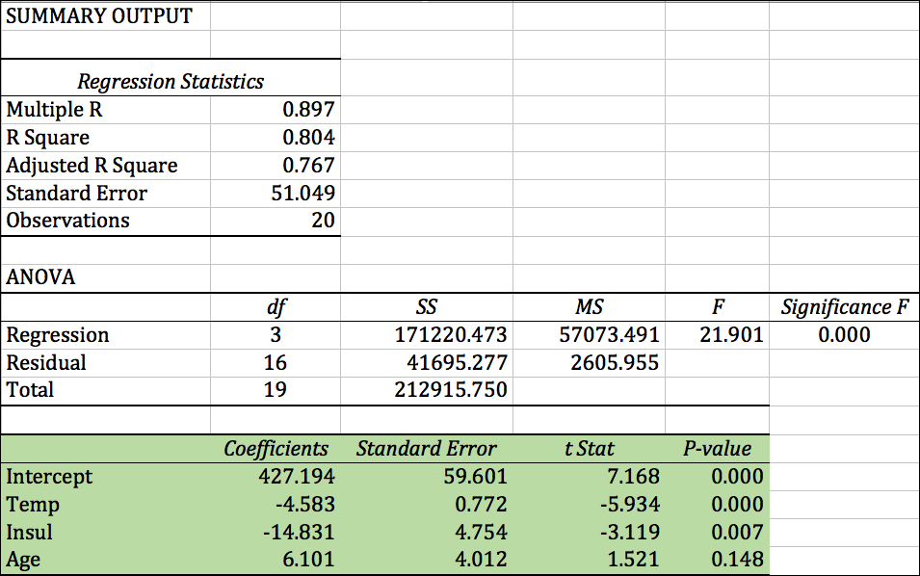
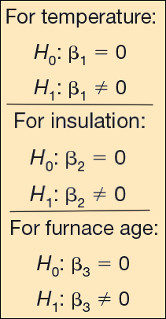
Multiple Regression Analysis: Evaluating Individual Regression Coefficients (β_{i} = 0)
LO14-3
Step 5: Take a sample, do the analysis, arrive at a decision.

Slide 19
Multiple Regression Analysis: Evaluating Individual Regression Coefficients (β_{i} = 0)
LO14-3
Step 6: Interpret the results.
The tests for each of the individual regression coefficients show that two independent variables, mean outside temperature and inches of insulation, are significantly related to heating cost. The results also show that the age of the furnace is not related to heating cost.
In fact, the results suggest that we can eliminate the “age of furnace” variable from the analysis. We then redo the multiple regression analysis without the “age of furnace” variable and calculate a new equation using only the temperature and inches of insulation variables.

Slide 20
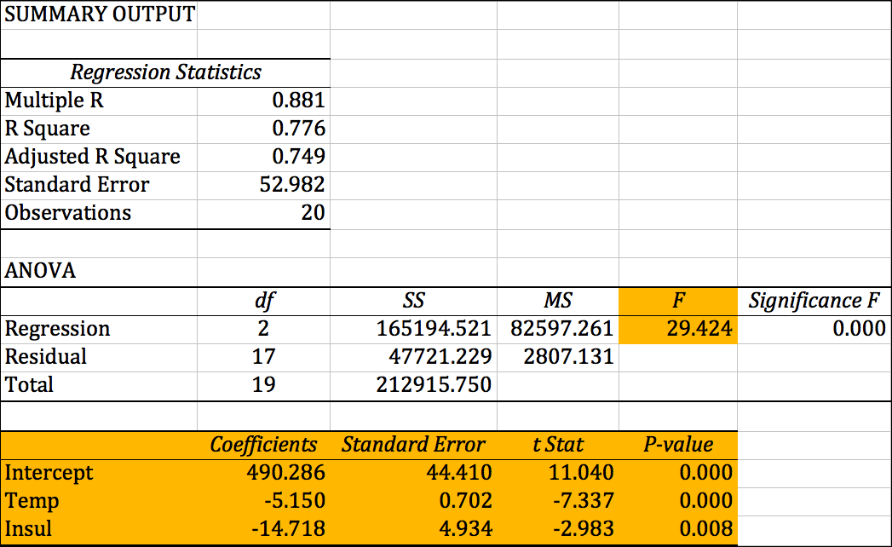
Multiple Regression Analysis: Evaluating Individual Regression Coefficients (β_{i} = 0)
LO14-3
Step 6: Interpret the results continued without furnace age.
What happened when furnace age is removed? Using all the previous steps in multiple regression analysis we find that:
The Global Test is rejected; at least one of the independent variables is significantly related to heating cost.
The Individual Tests of Regression Coefficients (Temperature and Insulation) reject the null hypotheses and we conclude that both mean temperature and inches of insulation are significantly related to heating cost.
The multiple regression equation is now:
Heating Cost = 490.286 – 5.150 (mean outside temperature) – 14.718 (inches of insulation)
The adjusted R² indicates the two independent variables account for 74.9% of the variation in heating cost.

Slide 21
Multiple Regression Analysis: Evaluating the Assumptions
LO14-4 Evaluate the assumptions of multiple regression.
The Assumptions:
There is a linear or straight-line relationship between the dependent variable and the set of independent variables.
The variation in the residuals, ( y - ŷ ), is unrelated to whether ŷ is large or small.
The residuals are normally distributed with a mean approximately equal to 0.
The independent variables should not be correlated. That is, we would a set of independent variables that are not themselves correlated.
The residuals are independent. This means that successive observations of the dependent variable are not correlated. This assumption is often violated when time is involved with the sampled observations.

Slide 22
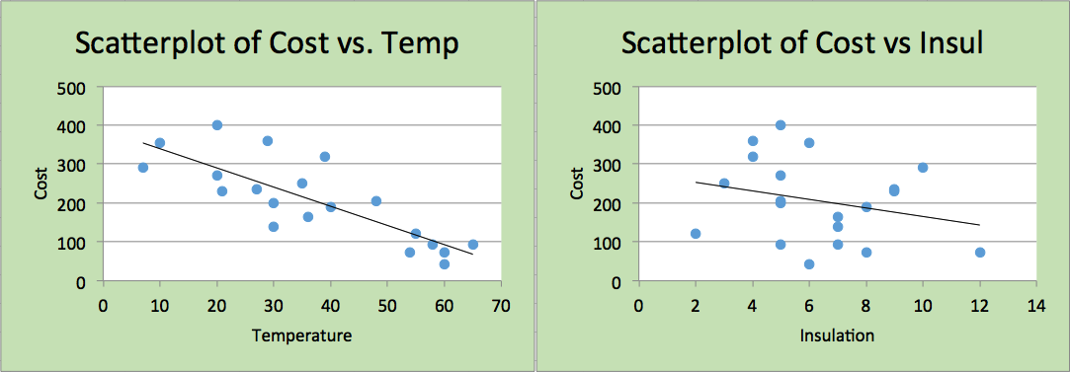
Multiple Regression Analysis: Evaluating the Assumptions- Scatter Plots
LO14-4
Scatter plots of the dependent variable versus each of the independent variables are used to evaluate the assumption that the relationship between the dependent variable and each independent variable is linear or a straight line.
These scatter plots indicate there are no obvious violations of this assumption. So we will not need to consider any transformations for non-linear relationships between the dependent and independent variables.

Slide 23
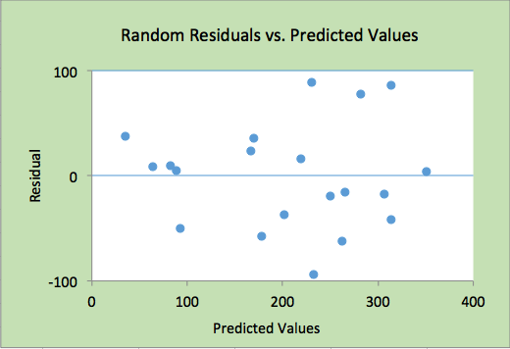
Multiple Regression Analysis: Evaluating the Assumptions- Scatter Plots
LO14-4
A scatter plot of the residuals versus the predicted values of y is used to evaluate the assumption that the variation in the residuals, ( y - ŷ ), is the same for both large and small values of ŷ. To put it another way, ( y - ŷ ) is unrelated to whether ŷ is large or small.
This scatter plot indicates there is no obvious violation of this assumption.

Slide 24
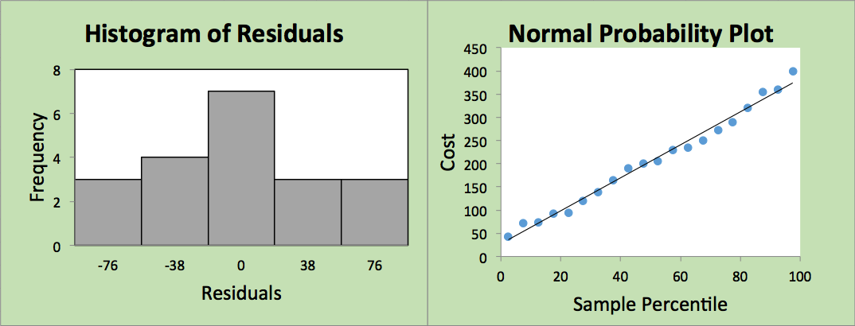
Multiple Regression Analysis: Evaluating the Assumptions- Distribution of Residuals
LO14-4
Two different graphs are used to evaluate the assumption that the residuals are normally distributed with a mean approximately equal to 0. The first is a histogram or graph of the frequency distribution of the residuals. The second is a Normal Probability Plot.
The histogram shows that the residuals are approximately normally distributed centered on zero.
In a normal probability plot, if the residuals are normally distributed, the points should approximate a line.
Both of these graphs support the assumption that the residuals are normally distributed. The histogram indicates that the mean of the residuals is zero.
Notes:
.

Slide 25
Multiple Regression Analysis: Evaluating the Assumptions - Multicollinearity
LO14-4
Multicollinearity exists when independent variables (X’s) are correlated.
Effects of Multicollinearity on the Model:
In a multiple regression analysis, an independent variable known to be an important predictor ends up having a regression coefficient that is not significant.
A regression coefficient that should have a positive sign turns out to be negative, or vice versa.
When an independent variable is added or removed, there is a drastic change in the values of the remaining regression coefficients.

Slide 26
Multiple Regression Analysis: Evaluating the Assumptions – Multicollinearity
LO14-4
A general rule is: if the correlation between two independent variables is between -0.70 and 0.70, multicollinearity between the two variables is most likely not a problem.
A more precise test of multicollinearity is to use the variance inflation factor (VIF).
If the VIF for an independent variable is more than 10, multicollinearity is likely and the independent variable should be removed from the analysis.
To compute a VIF for an independent variable, we must first conduct a multiple regression analysis using the independent variable as the dependent variable, and the remaining independent variables as the independent variables. From this analysis, we are only interested the R² value.
The value of VIF is found as follows:

Slide 27
Multiple Regression Analysis: Evaluating the Assumptions – Multicollinearity Example
LO14-4
Refer to the home heating cost multiple regression analysis using the independent variables: outside temperature, amount of insulation, and age of furnace.
The first evaluation is based on a correlation matrix of all the independent variables. The following correlation matrix highlights the correlations between each pair of independent variables.
None of the correlation coefficients are close to a value of 0.7 or -0.7. Therefore, this evaluation indicates that multicollinearity is not a problem.

Slide 28
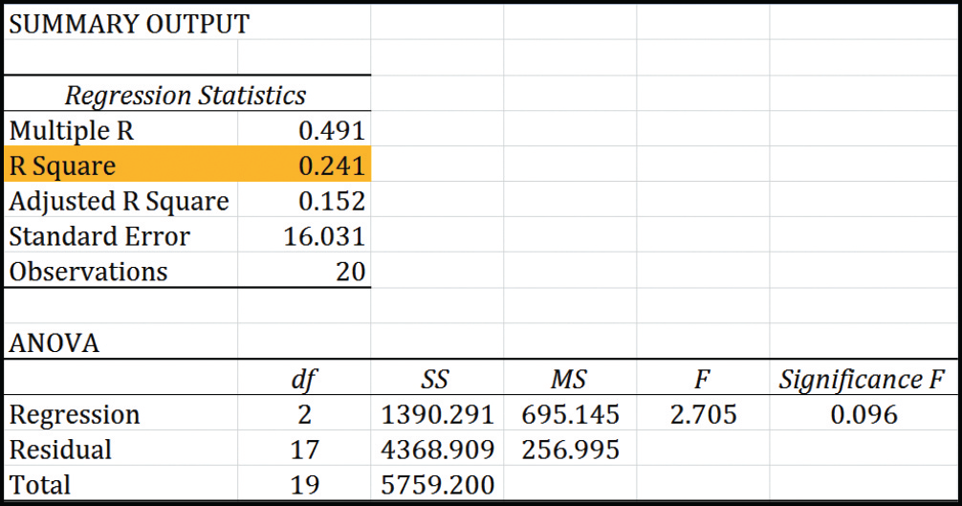
Multiple Regression Analysis: Evaluating the Assumptions – Multicollinearity Example
LO14-4
To further evaluate multicollinearity, we will calculate the VIF for the independent variable, temperature.
We conduct a multiple regression analysis on the following equation:
Average temperature = b₀ + b₁ ( inches of insulation) + b₂ ( age of the furnace)
The VIF value of 1.32 is less than the upper limit of 10. This indicates that the independent variable temperature is not strongly correlated with the other independent variables.
Notes:
.

Slide 29
Multiple Regression Analysis: Evaluating the Assumptions – Multicollinearity Example
LO14-4
Summary of VIF results.
The VIF values are all less than the upper limit of 10. This indicates that the independent variables are not strongly correlated.
Notes:
.

Slide 30
Multiple Regression Analysis: Evaluating the Assumptions –Independence
LO14-4
Our last assumption of multiple regression is that the residuals are independent. This means that successive observations of the dependent variable are not correlated. This assumption is often violated when time is involved with the sampled observations.
When successive residuals are correlated we refer to this condition as autocorrelation. Autocorrelation frequently occurs when the data are collected over a period of time.

Slide 31
Multiple Regression Analysis: Evaluating the Assumptions –Independence: Residual Plot versus Fitted Values
LO14-4
Note that a trend in a scatter plot of the residuals versus the predicted y, as shown to the right, would indicate possible autocorrelation.
Note that there is no evidence of autocorrelation in our home heating multiple regression.

Slide 32
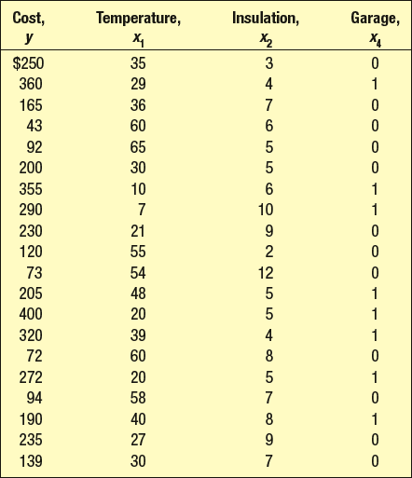
Multiple Regression Analysis: Using a Qualitative Independent Variable - Example
LO14-5 Use and interpret a qualitative, dummy variable in multiple regression.
In multiple regression we may want to include a nominal-scale variable—such as gender, whether a sports team was the home or the visiting team, or if a home has an attached garage. These are called qualitative or dummy variables.
To use a qualitative variable in regression analysis, we code the dummy variable as either a 0 or a 1. We then include the qualitative variable as an additional independent variable in the multiple regression analysis.
EXAMPLE
Suppose in the home heating cost example, we are interested to see if the presence of an attached garage has an effect on heating cost. We would add the independent variable “garage” and record the following information: for those homes without an attached garage, the garage variable is assigned a 0; for homes with an attached garage, the garage variable is assigned a 1.

Slide 33
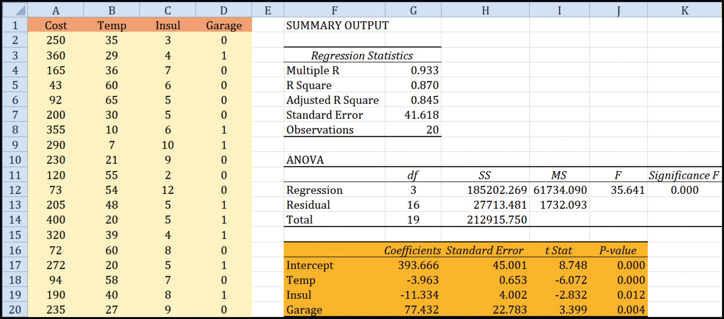
Multiple Regression Analysis: Using a Qualitative Independent Variable - Example
LO14-5
Note that the independent variable “garage” is now part of the analysis. The R² increased and the variable “garage” has a significant effect on the dependent variable, heating cost. The p-value is 0.004.
In fact, because we coded “garage” as 0 and 1, the results indicate that a home with an attached garage adds $77.432 dollars to the average heating cost of a home!

Slide 34
Multiple Regression Analysis: Interaction
LO14-6 Include and interpret an interaction effect in multiple regression analysis.
In all of the multiple regressions presented so far, each independent variable has a separate effect on the dependent variable. For example, in the following multiple regression equation,
we can say, focusing on the independent variable, “inches of insulation”, heating cost will decrease $14.718 for every additional inch of insulation, while holding the temperature constant. We cannot make any statements about the combined effect of the two independent variables on heating cost.
Heating Cost = 490.286 – 5.150 (mean outside temperature) – 14.718 (inches of insulation)
However, we can add another variable, called the interaction effect of temperature and inches of insulation to the model. The new variable is simply the product of the two independent variables (mean outside temperature)(inches of insulation) for each home.
Heating Cost = b₀ + b₁(mean outside temperature) + b₂ (inches of insulation) + b₃ (mean outside temperature)(inches of insulation)

Slide 35
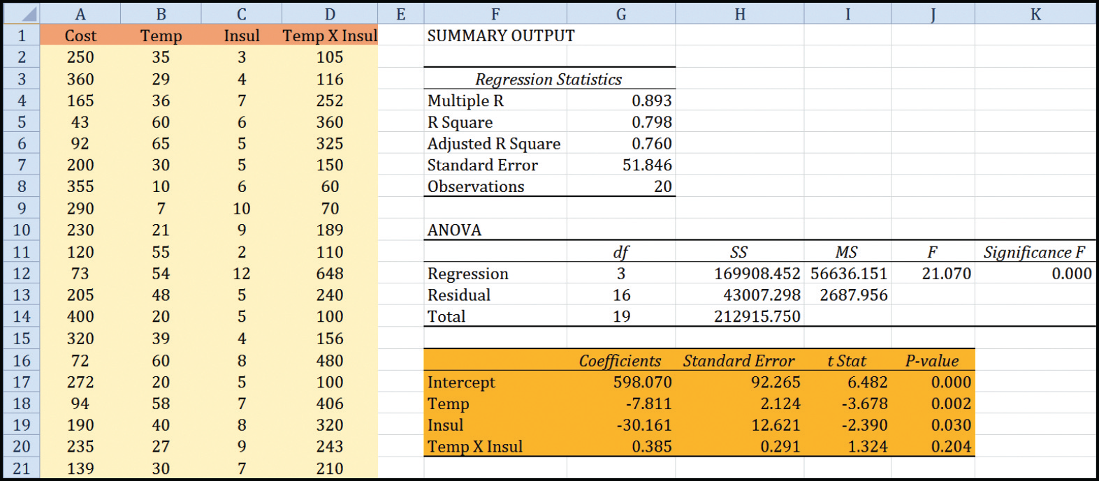
Multiple Regression Analysis: Interaction - Example
LO14-6
Note that the new independent variable “Temp X Insul” interaction is now part of the analysis. The R² had a very small increase. The interaction variable shows an insignificant effect on home heating cost. The p-value is 0.204.
The interaction effect of temperature and insulation should not be included in the regression equation.

Slide 36
Multiple Regression Analysis: Stepwise Regression
LO14-7 Apply stepwise regression to develop a multiple regression model.
Stepwise Regression is often available in statistical software packages. It is used to automatically sort through the set of independent variables by only selecting independent variables with significant regression coefficients as they relate to the dependent variable.
The selection of independent variables is based on selecting the variable that produces the largest increase in the R².
It is efficient in finding the regression equation with only significant regression coefficients.

Slide 37
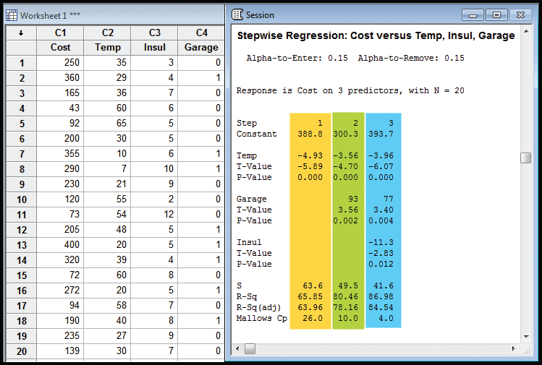
Multiple Regression Analysis: Stepwise Regression – Minitab Example
LO14-7
Temperature is the variable selected first. This variable explains more of the variation in heating cost than any of the other three proposed independent variables. Garage is selected next, followed by Insulation.
At each stage, you can observe the increase in the R² and the decrease in the standard estimate of the error (S).

