Slide 1
Chapter 3 Emerging Business Ethics Issues

Slide 2
Learning Objectives
Define ethical issues in the context of organizational ethics
Examine ethical issues as they relate to the basic values of honesty, fairness, and integrity

Slide 3
Learning Objectives (continued)
Delineate misuse of company resources, abusive and intimidating behavior, lying, conflicts of interest, bribery, corporate intelligence, discrimination, sexual harassment, fraud, insider trading, intellectual property rights, and privacy as business ethics issues
Examine the challenge of determining an ethical issue in business

Slide 4
Ethical Awareness
People make ethical decisions when they find an ethical component in a particular issue or situation
Failure to acknowledge or be aware of ethical issues is hazardous to an organization
Ethical issues involve a group, a problem, or an opportunity that requires introspection and investigation before a decision can be made

Slide 5
Foundational Values for Identifying Ethical Issues
Integrity
Honesty
Fairness

Slide 6
Ethical Issues in Business
Misuse of company time and resources
Time theft
Using company software and Internet services for personal business
Abusive or intimidating behavior
Physical threats and false accusations, profanity, and insults
Wage theft
Bullying

Slide 7
Ethical Issues in Business (continued 1)
Lying
Types - Joking without malice, lying by commission, and lying by omission
A lie may be unethical based on the context of the statement and its intent to distort the truth
Conflicts of interest: Exists when an individual must choose between his or her own interests and those of the organization or some other group

Slide 8
Ethical Issues in Business (continued 2)
Bribery
Types - Active bribery and passive bribery
Legalities of felicitation payments differ from country to country
Corporate intelligence: Collection and analysis of information regarding the external environment of a business
Types of intelligence models - Passive monitoring system for early warning, tactical field support, and support dedicated to top-management strategy

Slide 9
Ethical Issues in Business (continued 3)
Discrimination on the basis of race, color, religion, sex, marital status, public assistance status, disability, age, national origin, and veteran status
Illegal in the United States
Sexual harassment
Unwanted sexual approaches
Repeated remarks with the implied suggestion that the target’s employment status or favorable treatment depend on a positive response and/or cooperation

Slide 10
Ethical Issues in Business (continued 4)
Dual relationships cause direct or indirect conflicts of interest in professional judgement
Fraud
Types - Accounting fraud and marketing fraud
Categories of false or misleading advertisements
Puffery, implied falsity, and literally false
Labeling issues and ambiguous statements

Slide 11
Ethical Issues in Business (continued 5)
Consumer fraud
Examples of fraudulent activities
Shoplifting, collusion or duplicity, and guile
Financial misconduct
Dodd–Frank Wall Street Reform and Consumer Protection Act was passed to:
Increase accountability and transparency in the financial industry
Protect consumers from deceptive financial practices

Slide 12
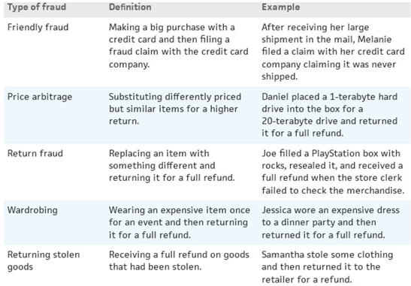
Table 3.5 - Types of Consumer Fraud
Source: Rich Johnson, “How Do Customers Take Advantage of Retailers,” Site Jabber, September 24, 2010, http://www.sitejabber.com/blog/2010/09/24/how-do-customers-take-advantage-of-retailers/ (accessed February 20, 2015).

Slide 13
Ethical Issues in Business (continued 6)
Insider trading
Types - Illegal and legal
Intellectual property rights
Legal protection of intellectual property such as music, books, and movies
Federal Copyright Office (FCO) laid the groundwork for intellectual property rules

Slide 14
Ethical Issues in Business (continued 7)
Privacy issues
Monitoring of employees’ use of available technology
Consumer privacy
Dimensions to consumer privacy
Consumer awareness of information collection
Lack of consumer control over the personal information collected

Slide 15
Determinants of an Ethical Issue in Business
Stakeholder concerns about an event, activity, or the results of a business decision
Discussions generated by mass media, special interest groups, and individuals
Asking other people in the business about their opinion on ethical components of the organization
Societal values

