Slide 1
Chapter 2
Stakeholder Relationships, Social Responsibility, and Corporate Governance

Slide 2
Learning Objectives
Identify stakeholders’ roles in business ethics
Define social responsibility
Examine the relationship between stakeholder orientation and social responsibility
Delineate a stakeholder orientation in creating corporate social responsibility

Slide 3
Learning Objectives (continued)
Explore the role of corporate governance in structuring ethics and social responsibility in business
List the steps involved in implementing a stakeholder perspective in social responsibility and business ethics

Slide 4
Relationships and Business
Relationships are associated with both organizational success and misconduct
  Businesses exist because of organizational relationships between employees, customers, shareholders, and the community
Stakeholder framework identifies the internal and external stakeholders who agree, collaborate, and engage in confrontations on ethical issues
  Allows organizations to identify, monitor, and respond to the needs and expectations of stakeholder groups

Slide 5
Stakeholders
People who have a stake or claim in some aspect of a company’s operations, markets, and industry
Approaches to stakeholder theory
  Normative - Sets forth ethical guidelines that dictate how firms should treat stakeholders
  Descriptive - Focuses on the actual behavior of a firm and addresses how decisions and strategies are made for stakeholder relationships
  Instrumental - Describes what happens if a firm behaves in a particular way

Slide 6
Role of Stakeholders
Foster decision making
  The level of social responsibility of an organization can be assessed by scrutinizing its effects on the issues of concern to its stakeholders
Provide resources that are critical to a firm’s long-term success

Slide 7
Types of Stakeholders
Primary stakeholders
People whose support and resources are needed for a firm’s survival
Include employees, customers, and shareholders
Secondary stakeholders
Do not engage directly in transactions with a company
Include the media and trade associations
Not essential to a firm’s survival

Slide 8
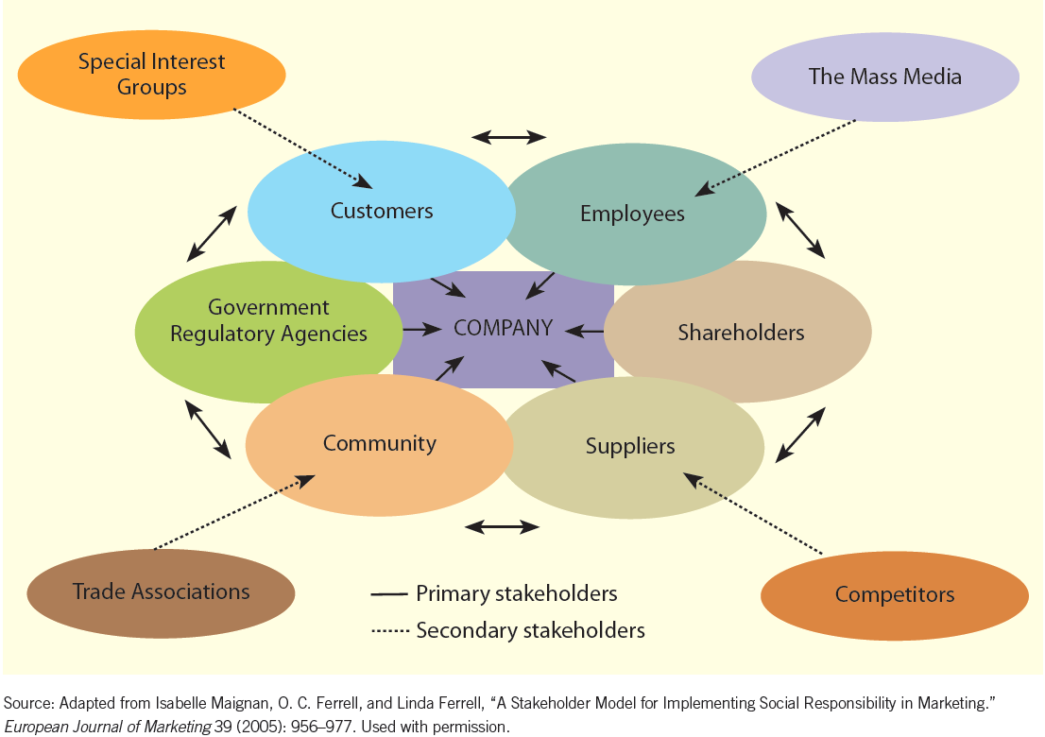
Figure 2.2 - Interactions between a Company and Its Primary and Secondary Stakeholders

Slide 9
Stakeholder Orientation
Degree to which a firm understands and addresses stakeholder demands
Consists of the following activities:
  Organization-wide generation of data about stakeholder groups and assessment of the firm’s effects on these groups
  Distribution of the generated data throughout the firm
  Responsiveness of the organization as a whole to the data generated

Slide 10
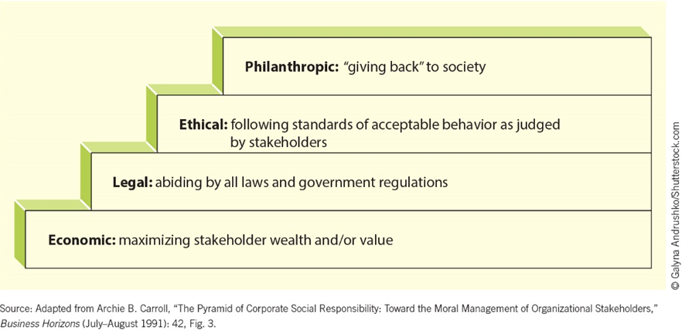
Figure 2.3 - Steps of Social Responsibility

Slide 11
Corporate Citizenship
Degree to which businesses strategically meet the economic, legal, ethical, and philanthropic responsibilities placed on them by their stakeholders
Dimensions
  Strong sustained economic performance
  Rigorous compliance
  Ethical actions beyond what the law requires
  Voluntary contributions that advance the reputation and stakeholder commitment of the organization

Slide 12
Issues in Social Responsibility
Social issues
Consumer protection
Sustainability
Corporate governance

Slide 13
Importance of Stakeholder Orientation in Social Responsibility
Friedman’s view - Stakeholders do not have any role in requiring businesses to demonstrate responsible and ethical behavior
Adam Smith’s view - Values that a firm should adopt to produce in a more socially responsible way correlates with the needs and concerns of the stakeholders
Stakeholder support for companies that are socially responsible enhances a firm’s profitability

Slide 14
Corporate Governance and Stakeholders
Corporate governance provides formalized responsibility to stakeholders
  Directors and officers of corporations - Fiduciaries for the shareholders
    Directors perform a duty of diligence and share a duty of loyalty
Accountability - Degree to which workplace decisions align with a firm’s goals and its compliance with ethical and legal considerations

Slide 15
Corporate Governance and Stakeholders (continued)
Corporate governance establishes systems and processes for:
  Preventing and detecting misconduct
  Investigating and disciplining
  Recovery and continuous improvement
The development of a stakeholder orientation should interface with the corporation’s governance structure

Slide 16
Models of Corporate Governance
Shareholder model
  Goal - Maximize wealth for investors and owners
  Focuses on developing and improving the formal system for maintaining performance accountability between top management and shareholders
Stakeholder model
  Company is answerable to its stakeholders
  Promotes stakeholder welfare along with corporate needs and interests

Slide 17
Board of Directors
Responsible for the ethics of a firm’s actions
  Have a fiduciary duty
Assume ultimate authority for their organization’s effectiveness and subsequent performance
Governed by the amendments of the Federal Sentencing Guidelines for Organizations (FSGO)

Slide 18
Demand for Accountability and Transparency
Directors today are increasingly chosen for their expertise, competence, and ability to bring diverse perspectives to strategic discussions
  Outside directors are hired as they do not have vested interests
  The concept of interlocking directorate is not illegal unless it involves a direct competitor
    Interlocking directorate: Board members linked to more than one company

Slide 19
Executive Compensation
Compensation paid to top executives of the company
Ratio between the salaries of the highest-paid executives and the median employee wage should be less
  Stakeholders support high level of compensation only when it is linked to strong company performance

Slide 20
Steps to Implementing a Stakeholder Perspective
Assessing the corporate culture
Identifying stakeholder groups and issues
Assessing organizational commitment to social responsibility
Identifying resources and determining urgency
Gaining stakeholder feedback

