Slide 1
Part Two
Ethical Issues and the Institutionalization of Business Ethics
Chapter 4
The Institutionalization of Business Ethics

Slide 2
Institutionalization in Business Ethics
Three dimensions of institutionalization
Voluntary practices: Beliefs, values, and voluntary contractual obligations of a business
Philanthropy: Giving back to communities and causes
Core practices: Documented best practices, often encouraged by legal and regulatory forces and trade associations
The Better Business Bureau can provide direction
Mandated boundaries: Externally imposed boundaries of conduct (e.g. laws, rules, regulations and other requirements)

Slide 3
Legal Compliance
Government established laws/regulations
Set minimum standards for responsible behavior
Stakeholders demanded laws involving consumer safety and environmental protection
Laws help businesses determine what society believes at a certain time, but laws change
Telling employees to ‘obey the law’ is meaningless without training in legal risk areas

Slide 4
Elements of an Ethical Culture

Slide 5
Types of Laws
Civil law defines the rights and duties of individuals and organizations
Individuals (in court) enforce civil laws
Criminal law prohibits specific actions and imposes punishments for breaking the law
State or nation enforces criminal laws

Slide 6
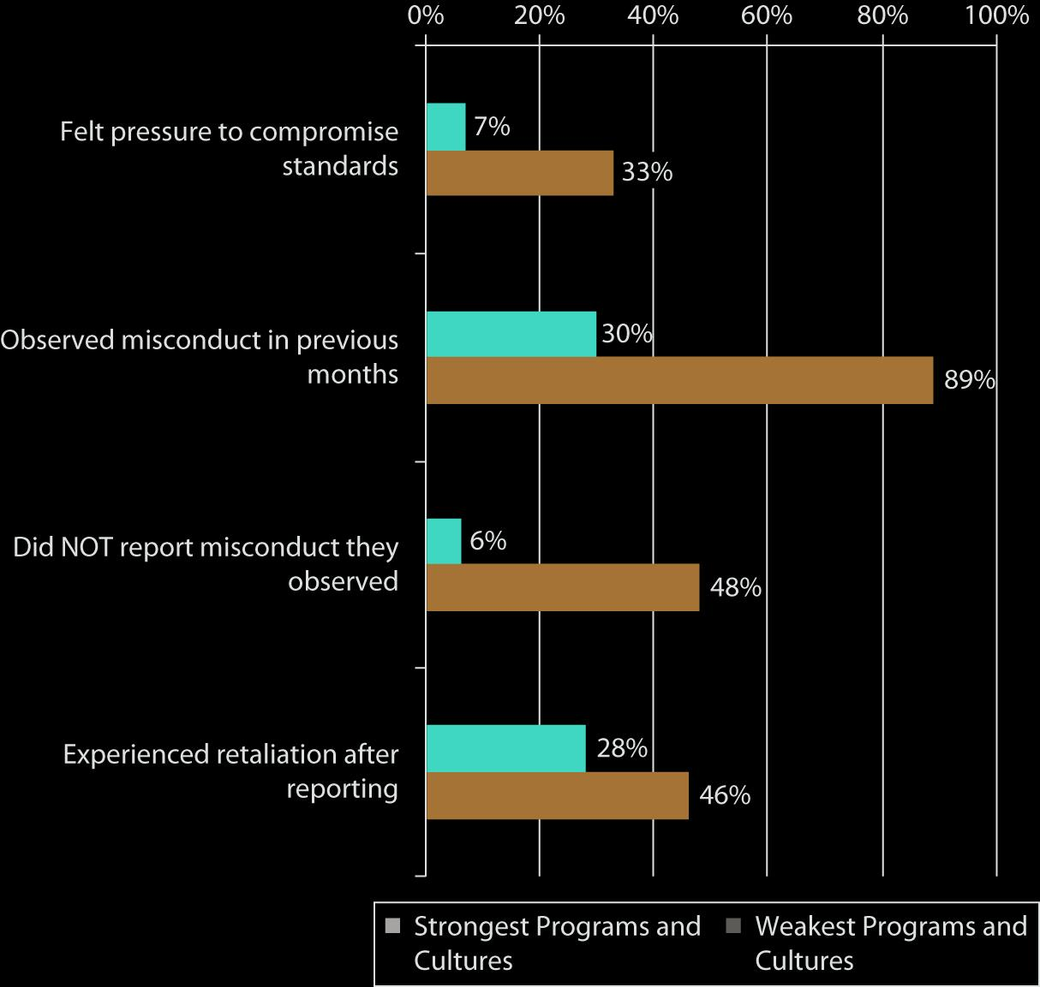
Well-Implemented Ethics Program and Strong Cultures Reduce Risk
Source : Ethics Resource Center, 2011 National Business Ethics Survey: Workplace Ethics In Transition (Arlington, VA: Ethics Resource Center, 2012), 35.

Slide 7
Mandated Requirement for Legal Compliance
Laws establish the basic ground rules for responsible business activities
Five categories of laws
Regulating competition
Protecting consumers
Promoting equity and safety
Protecting the environment
Incentives to encourage organizational compliance programs to deter misconduct

Slide 8
Laws Regulating
Competition
Laws passed to prevent monopolies, inequitable pricing, and other practices that reduce or restrict competition
Sometimes called procompetitive legislation because they encourage competition and prevent activities that restrain trade

Slide 9
Laws Protecting Consumers
Consumer protection laws require businesses provide accurate information about products and services and follow safety standards
The FTC’s Bureau of Consumer Protection guards against unfair, deceptive, or fraudulent practices
The FDA regulates food safety, human drugs, and tobacco, among other things
Groups with specific vulnerabilities have higher levels of legal protection

Slide 10
Laws Promoting Equity and Safety
Title VII of the Civil Rights Act
Equal Employment Opportunity Commission (EEOC)
Affirmative action programs
The Equal Pay Act
Americans with Disabilities Act
Occupational Safety and Health Administration (OSHA) makes inspections to ensure a safe working environment

Slide 11
Gatekeepers and Stakeholders
Trust is the glue that holds businesses and their stakeholders together
Gatekeepers: Overseers of business actions
Accountants, regulators, lawyers, financial rating firms, auditors
Critical in providing accurate information to stakeholders

Slide 12
Accountants
Measure and disclose financial information to the public
Assure accuracy
Some accountants have not adhered to their stakeholder responsibilities
Excessive focus on growth and profits
Conflicts of interest

Slide 13
Risk Assessors
Assess financial risk and express that risk through letter ratings from “AAA” to “C”
Problems with risk models and violations of codes of conduct led to inaccurate ratings
Misled investors and stakeholders
Regulators believe more oversight is needed for credit-rating firms

Slide 14
The Sarbanes-Oxley (SOX) Act
Established a system of federal oversight of corporate accounting practices
Public Company Accounting Oversight Board (PCAOB) authority to monitor accounting firms that audit public companies
Reduces conflict of interest and increases accountability
Some legal protection for whistleblowers
Jumpstart Our Business Startups (JOBS) Act

Slide 15
Dodd-Frank Wall Street Reform and Consumer Protection Act
Seeks to improve financial regulation, increase oversight, and prevent excessive risk-taking, deceptive practices and lack of oversight
Created new offices
The Office of Financial Research
The Financial Stability Oversight Council
Consumer Financial Protection Bureau (CFPB)
Instituted a whistle-blower bounty program

Slide 16
Federal Sentencing Guidelines for Organizations
FSGO urges organizations to develop and implement compliance programs
Guidelines apply to all felonies and class-A misdemeanors committed by employees
Philosophy that legal violations can be prevented through organizational values and commitment to ethical conduct
2012 proposed amendments call for increased penalties for certain types of security fraud

Slide 17
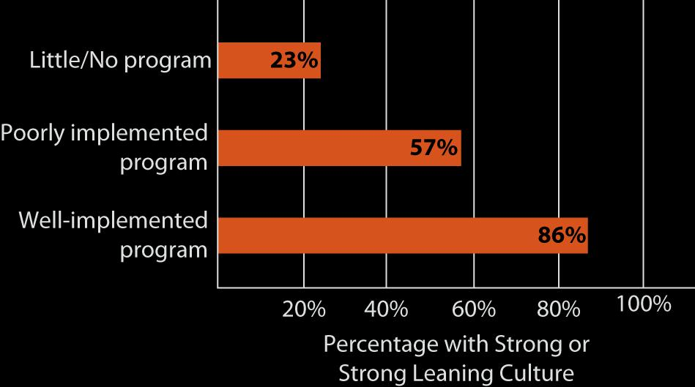
Ethics Program
Implementation
Source: Ethics Resource Center, 2011 National Business Ethics Survey (Arlington, VA: Ethics Resource Center, 2012), 34.

Slide 18
Highly Appropriate Core Practices
Focus on sound organizational practices and integrity for performance measures
Not a focus on individual morals
Most ethical issues are non-financial
The Sarbanes-Oxley Act and Dodd-Frank Act provide standards for financial performance
The Integrity Institute developed a model that standardizes measures of non-financial performance

Slide 19
Voluntary Responsibilities
Business’s contributions to stakeholders
Four major benefits to society
Improves communities quality of life
Reduces government involvement
Develops employee leadership skills
Helps create an ethical culture
Cause-related marketing: Ties an organization’s product(s) to a social concern through a marketing program
Strategic philanthropy: The synergistic and mutually beneficial use of core competencies and resources to deal with stakeholders, benefit the company and society

Slide 20
Institutionalization in Business Ethics
Involves embedding values, norms, and artifacts in organizations, industries, and society
Failure to understand highly appropriate core practices provides the opportunity for unethical conduct
Institutionalization of business ethics has advanced rapidly over the last 20 years

