Slide 1
Part One
An Overview of Business Ethics
Chapter 2 Stakeholder Relationships, Social Responsibility and Corporate Governance

Slide 2
Relationships and Business
Building effective relationships is one of the most important areas of business today
Business ethics is a team sport and few decisions are made by only one individual
Stakeholder framework
Helps identify internal and external stakeholders
Helps monitor and respond to needs, values, and expectations of stakeholder groups
Corporate governance
The formal system of accountability and control of ethical and socially responsible behavior

Slide 3
Stakeholders Define Ethical Issues in Business
Stakeholders: Those who have a stake or claim in some aspect of a company’s products, operations, markets, industry, and outcomes
Customers Investors
Employees Suppliers
Government agencies Communities
The relationship between companies and their stakeholders is a two-way street

Slide 4
Stakeholder Theory
Three approaches to stakeholder theory
Normative
Principles and values help identify ethical guidelines that dictate how to treat stakeholders
Descriptive
Focuses on actual behavior, addressing decisions and strategies in stakeholder relationships
Instrumental
Examines stakeholder relationships and describes outcomes for particular behaviors

Slide 5
Identifying Stakeholders
Primary stakeholders: those whose continued association is absolutely necessary for a firm’s survival
Employees, customers, investors, governments, and communities
Secondary stakeholders: do not typically engage in transactions with the firm and are not essential to a firm’s survival
Media, trade associations, and special interest groups

Slide 6
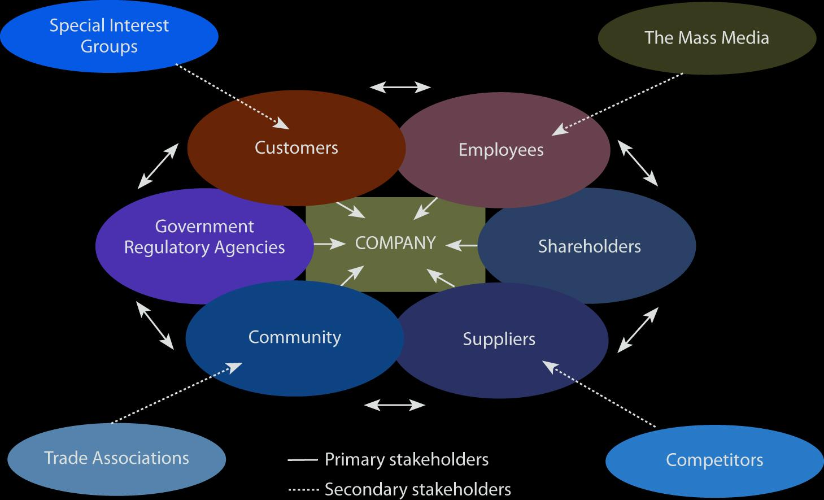
The Stakeholder Interaction Model
Source: Adapted from Isabelle Maignan, O. C. Ferrell, and Linda Ferrell, “A Stakeholder Model for Implementing Social Responsibility in Marketing.” European Journal of Marketing 39 (2005): 956–977. Used with permission.

Slide 7
A Stakeholder
Orientation
The degree to which a firm understands and addresses stakeholder demands
Involves activities that facilitate and maintain value with stakeholders
Generation of data about stakeholder groups
Distribution of that information
Responsiveness of the organization as a whole

Slide 8
Social
Responsibility
An organization’s obligation to maximize its positive impact on stakeholders and minimize its negative impact
Four levels of social responsibility
Economic
Legal
Ethical
Philanthropic

Slide 9
The Steps of Social Responsibility
Source: Adapted from Archie B. Carroll, “The Pyramid of Corporate Social Responsibility: Toward the Moral Management of Organizational Stakeholders,” Business Horizons (July–August 1991): 42, Fig. 3.

Slide 10
Corporate Citizenship
The extent to which businesses strategically meet their economic, legal, ethical, and philanthropic responsibilities
Four interrelated dimensions
Strong sustained economic performance
Rigorous compliance
Ethical actions beyond what is legally required
Voluntary contributions to advance reputation and stakeholder commitment

Slide 11
The World’s Most Ethical Companies
L’ORÉAL | Petco
Xerox | Kellogg Company
OfficeMax | Starbucks
Cummins, Inc. | Target
Ford Motor Company | Salesforce.com, Inc.
General Electric | T-Mobile USA
PepsiCo | Hasbro
Whole Foods Market | Microsoft Corporation
Aflac | ARAMARK
Source: Ethisphere Institute, “2013 World’s Most Ethical Companies,” Ethisphere,
http://m1.ethisphere.com/wme2013/index.html (accessed March 7, 2013).

Slide 12
Reputation
Reputation is one of an organization’s greatest intangible assets with tangible value
Difficult to quantify but very important
A single negative incident can influence an organization’s image and reputation instantly and for years afterwards

Slide 13
Social Responsibility
Issues
Social
Deals with concerns that affect the welfare of our entire society, associated with the common good
Consumer Protection
The company has the responsibility of taking precautions to prevent consumer harm
Sustainability
Businesses can no longer afford to ignore the natural environment as a stakeholder
Corporate Governance
Research shows corporate governance has a strong positive relationship with social responsibility

Slide 14
Social Responsibility and Stakeholder Orientation
Caring about stakeholders can lead to increased profits
The purpose of a stakeholder orientation is to maximize positive outcomes that meet stakeholder’s needs
Stakeholders support companies they perceive to be socially responsible, enhancing profitability

Slide 15
Best Corporate
Citizens
1. Bristol-Myers Squibb
2. International Business Machines Corp.
3. Intel Corp.
4. Microsoft Corporation
5. Johnson Controls Inc.
6. Accenture plc
7. Spectra Energy Corp.
8. Campbell Soup Co.
9. Nike, Inc.
10. Freeport-McMoran Copper & Gold Inc.
Source: CR’s 100 Best Corporate Citizens 2012 , http://www.thecro.com/files/100Best2012_List_3.8.pdf (accessed February 14, 2013).

Slide 16
Corporate Governance
Formal systems of accountability, oversight, and control
Accountability
How closely workplace decisions align with a firm’s strategic direction
Oversight
A system of checks and balances to minimize opportunities for misconduct
Control
The process of auditing and improving organizational decisions and actions

Slide 17
Corporate Governance Topics
Executive Compensation
Enterprise-Wide Risk Management
Short- and Long-Term Strategies
Board Composition and Structure
Shareholder Relations
CEO Selection, Termination, and Succession Plans
Role of the CEO in Board Decisions
Auditing, Control, and Integrity of Financial Reporting
Compliance with Government Regulation and Reform
Organizational Ethics Programs
Source: “Corporate Alert: Top 10 Topics for Directors in 2011,” December 6, 2010, http://www.corpgov.deloitte.com/binary/com.epicentric.contentmanagement.servlet.ContentDeliveryServlet/USEng/Documents/Board%20Governance/Top%2010%20Topics%20for%20Directors%20in%202011_Akin_120610.pdf (accessed February 15, 2011).

Slide 18
Changes in Corporate Governance
40 % of boards split the CEO and Chair functions
Boards are getting smaller, with an average of 11 members ( 5 : 1 ratio independent: non-independent)
74 % of boards have mandatory retirement rules for directors
Almost all boards conduct annual board performance evaluations
71 % limit the time that board members can serve on outside boards
21 % of new directors are women, although 10 % of boards have no women directors
Over 50 % of CEOs in the S&P 500 do not serve on outside boards
Important characteristics in directors: strong financial background, industry background, and international experience
Average board member retainer: $ 20,00 in 1986 ($ 40,000 in today’s dollars) and $ 80,000 in 2010
Average total director compensation has risen to $ 215,000 in 2010
Source: Julie Hembrock Daum, “How Corporate Governance Changed from 1986–2010,” Business Week , http://www.businessweek.com/managing/content/nov2010/ca2010118_316346.htm (accessed April 2, 2013).

Slide 19
Views of Corporate Governance
Shareholder model
Founded in classic economic precepts
Maximizing wealth for investors and owners
Stakeholder model
A broader view of the purpose of business
Includes satisfying concerns of primary stakeholders including employees, suppliers, regulators, communities and special interest groups

Slide 20
Role of Board of Directors
Holds final responsibility for its firm’s success, failure, and ethicality of actions
The global financial crisis motivated many to demand greater accountability from boards
In reality, boards rarely manage but instead monitor executive decisions
Executive compensation is a growing ethical concern

Slide 21
Demands for Accountability and Transparency
Stakeholders demand that boards are accountable and transparent
Directors offer expertise, competence, and diverse perspectives to strategic decisions
Qualified, knowledgeable, diverse, unbiased boards can prevent misconduct
Interlocking directorate is the concept of board members being linked to more than one company

Slide 22
Executive Compensation
Many boards spend more time discussing compensation than ensuring integrity of financial reporting systems
How closely linked is executive compensation to company performance?
Does performance-linked compensation encourage executives to focus on short-term performance at the expense of long-term growth?

Slide 23
Implementing a Stakeholder Perspective
Assessing the corporate culture
Identifying stakeholder groups
Identifying stakeholder issues
Assessing organizational commitment to social responsibility
Identifying resources and determining urgency
Gaining stakeholder feedback

